Slide 1

International Energy Forum
St. Gallen, November 27, 2014
The EU-Russia energy relations: Russian view
Alexei Ispolinov
Head of International Law department
Moscow State University
e-mail: ispolinov@inbox.ru

Slide 2

Statistics of gas supply from Russia
30 % of gas import to Europe comes from Russia
50% of Russian gas goes via Ukrainian territory
*(before the start of the Nord Stream pipeline) – 80%
Almost 40% of Gazprom’s revenues – from export to Europe
20% revenues - gas delivered through Ukraine
2

Slide 3
EU reform of energy market -successful transformation of the energy industry
3 pillars of the EU liberalization
From monopoly to competition
Networks unbundling
3rd party access
RESULT: changes in the mentality of the energy market
3

Slide 4
Critical voices from Russia
“Gazprom clause” and energy security for Europe - new subjective factor in the EU certification process?
2) Open clash with Gazprom’s model of doing business in Europe
3) Threat to Gazprom’s active use of bilateral agreements and arrangements with EU member states
4) Lack of proper understanding of the EU logic and the specific of EU law
4

Slide 5
EU and Russia concerns: well- grounded or not?
EU worries:
Energy import dependency
Energy security
Energy dependence will be transformed into political influence
Russian concerns:
Political influence: steps and decisions have no economic rationale but purely politically motivated
The buyer unilaterally changes the rules for the biggest seller
Discrimination
Double standards – OPAL and North Stream
TAP –fully exempted from TEP
5

Slide 6
South Stream pipeline
Inside or outside the TEP?
Under all TEP requirements - impossible to build
Could be build using the exemptions to be granted by NRA and the Commissions (preferable solution of the EU) even after FID
Gazprom suggestion - “open seasons” approach
Russia’s complain to WTO as additional constrain
Project of common interests (PCI) approach, but the South Stream is not in the list
6

Slide 7
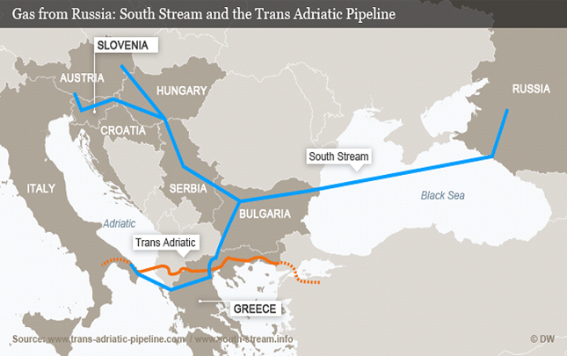
South Stream: general considerations
- increase of dependency from Russia ?
- way to avoid transit via Ukraine and other countries?
1) economic view: both streams will improve the EU energy security (no transit risks, no transit payments)
2) political view: in light of Ukrainian crisis: possible consequences for EU-Russian relations
7

Slide 8
Future of the EU-Russia energy relations
Decisive factors
Energy security is a main target for EU
The EU as a single buyer, one gas contract with EU
Policy of diversification:
1) diversification of the gas suppliers: Azeri and Iranian gas
2) diversification of the routes
Prevalence of political considerations
8

Slide 9
Russian view and priorities
Change of political logic
no partnership, but competition
Change of the business model:
diversification of the buyers
diversification of the routes
9

Slide 10
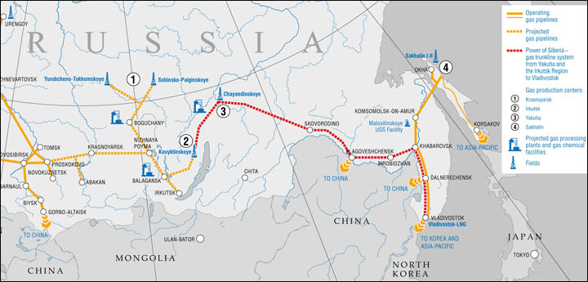
Changes of the Russian strategy
diversification of the routes and buyers
pipelines from Russian Western Siberia to Europe
“Power of Siberia” (“Eastern route”) – gas from Eastern Siberia – to China and Japan
“Altay” (“Western route”) – gas from Western Siberia (currently to Europe exclusively) - to China without any transit countries
Creation of the new playing field for the EU
10

Slide 11
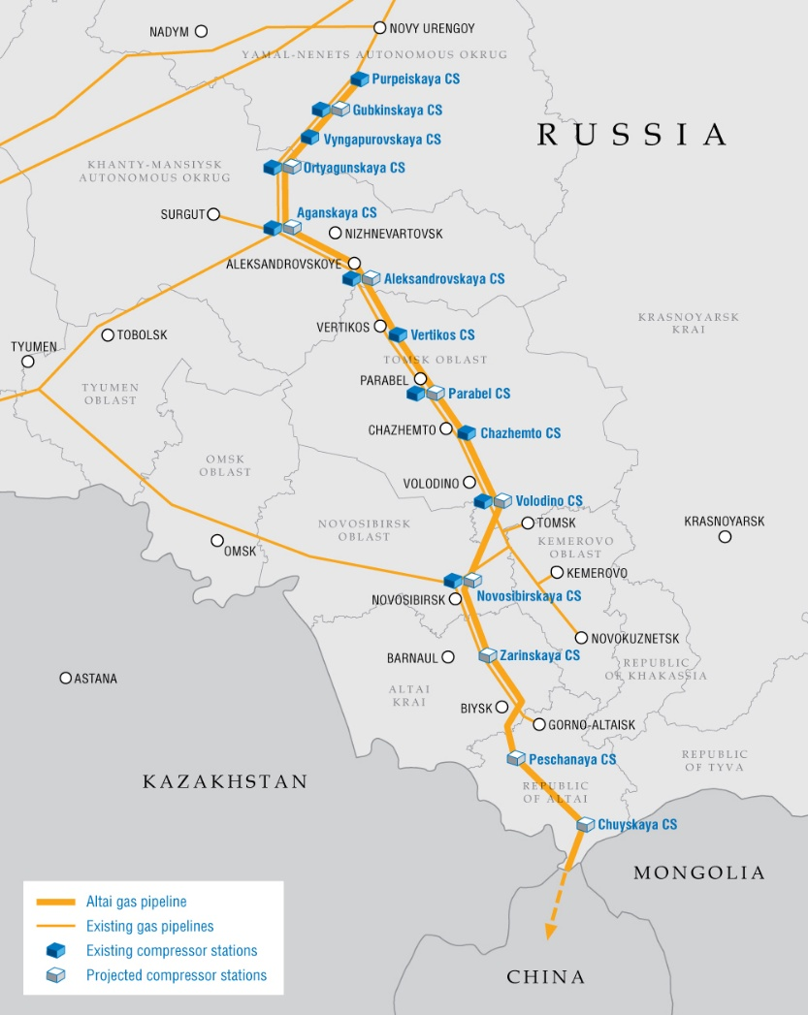
“Altay” (Western route): overview

Slide 12
Changes in the Russian gas market
The EU as an example of successful transformation
Russian liberalization of the gas market:
Introduction of competition , 3rd party access to the networks
Gazprom is rapidly losing its market share :
In 2014 – 66% (2013 -69%, 2010 -79%)
In 2014 NovaTEK -12%, Rosneft – 6,5%
By 2020 NovaTEK - 20%, Rosneft – 20%
Stock exchange trade with gas – re-launched in 2014
Up to 10% of the domestic market
Abolishment of export monopoly - LNG export
New LNG export facilities
11

Slide 13
Creation of the common gas market in the Eurasian Union
January 1, 2015 - Eurasian Union will be established
January 1, 2015 - approval of the concept of the creation of the common gas market
January 2017 – action program elaboration
January 2024 - deadline for implementation of the action plan
From January 1, 2025 - Eurasian common gas market
12

Slide 14
Conclusions
The EU and Russia – competitors or partners?
Russian - EU partnership agreement?
The EU – EEU agreement on equal basis
17

Slide 15

Thank You for attention!

