Slide 1
Migration: The Trends of the Contemporary and Future World
CENTER FOR STRATEGIS STUDIES UNDER THE PRESIDENT OF THE REPUBLIC OF TAJIKISTAN
Jovid Ikromov
Department of Social Issue Analysis

Slide 2
i. Migration: Contemporary trends
Four migration pathways:
South to North
North to North
North to South
South to South

Slide 3
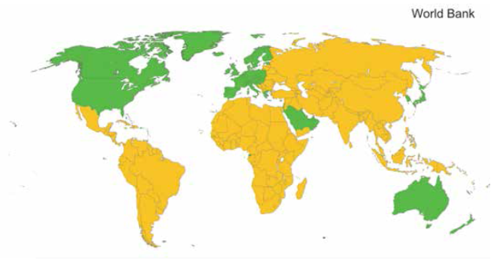

Slide 4
N
37 m.
N
95 m.
7m.
75 m.
S
S

Slide 5




Top five corridors on each of the four pathways

Slide 6
Top immigration countries
(% OF POPULATION)

Slide 7
TOP EMIGRATION COUNTRIES
(NUMBER OF EMIGRANTS, MILLION)

Slide 8
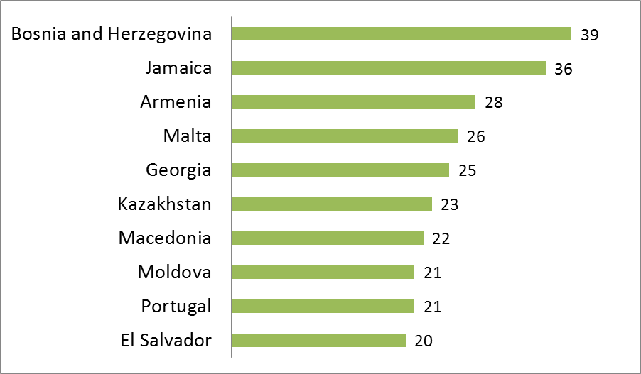
TOP EMIGRATION COUNTRIES
(% OF POPULATION)

Slide 9
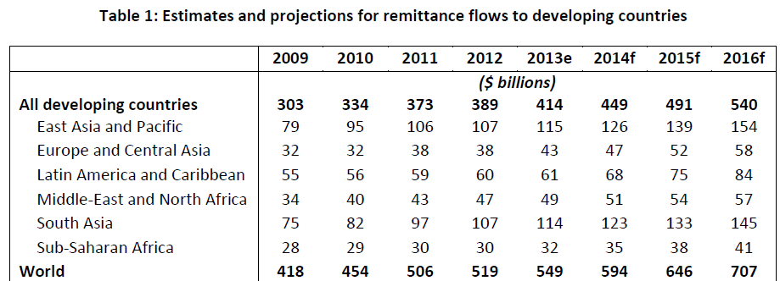
Remittances

Slide 10
World Desire for Permanent Migration vs. Plan vs. Preparation
Desire
13%
Plan
9%
Preparation
36%
630 million
56 million
20 million

Slide 11
Main reason for desire to move to another country permanently

Slide 12
MIGRATION KEY DRIVERS
Population growth
Increased urbanization
a widening divide between countries with youthful and quickly aging populations
Rapidly growing middle class
Unemployment
Notes:
Despite a growing global population, the availability of skilled workers is actually shrinking, and no longer just in advanced, aging countries such as Japan and Italy. Now, some emerging markets, such as China and Russia, are also feeling a demographic pinch.

Slide 13
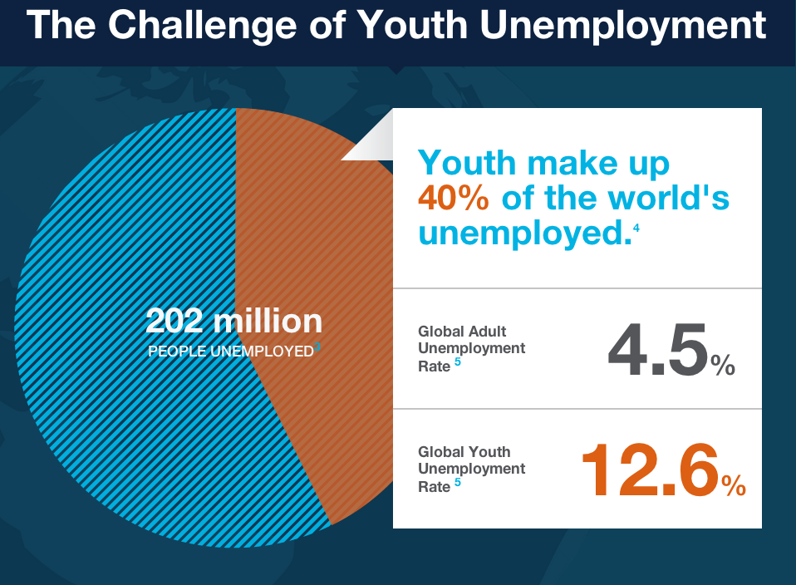

Slide 14
global population
7.8 billion
2020
7 billion
2013

Slide 15
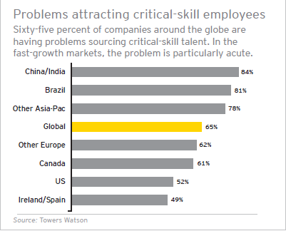
Migration paradox?

Slide 16
FUTURE OF MIGRATION
Further increase in migration due to:
Population growth
Declines in the cost of long-distance travels
World economy integration

Slide 17
Migration: Challenges or opportunities?
Notes:
Учитывая тот факт, что социально-экономические последствия миграции трудно поддается измерению, дискуссия относительно миграционной политики должна быть основана на серьезных научно-исследовательских работах. Данный момент, эти дискуссии основаны на эмоциях и взглядах, но прогресс не будет достигнут, до тех пор пока не будут серьезные эмпирические исследования. Надеемся, что в ходе данного собрания мы сможем, достигнут таких успехах, которые не хватает мировому сообществу по вопросам миграции.

