Slide 1
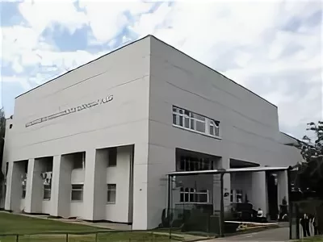
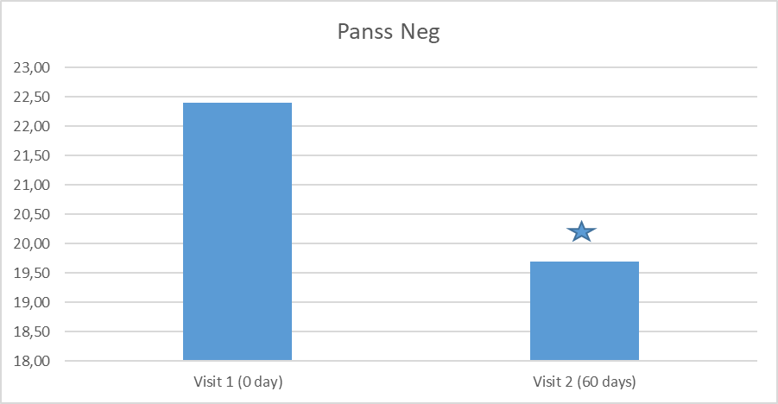
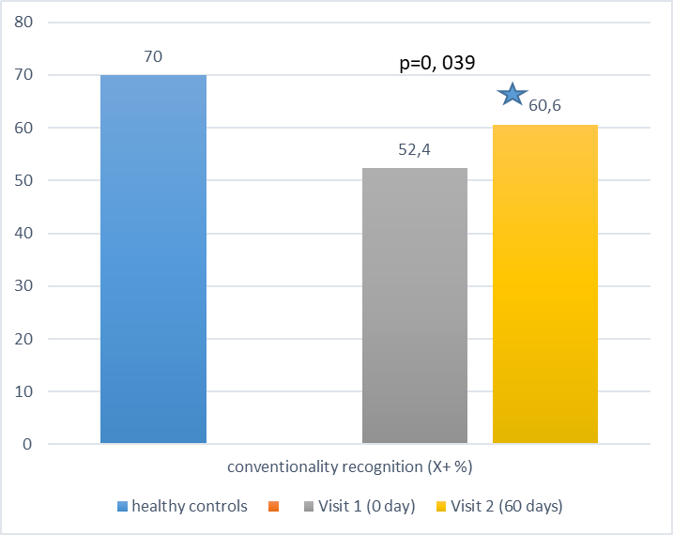
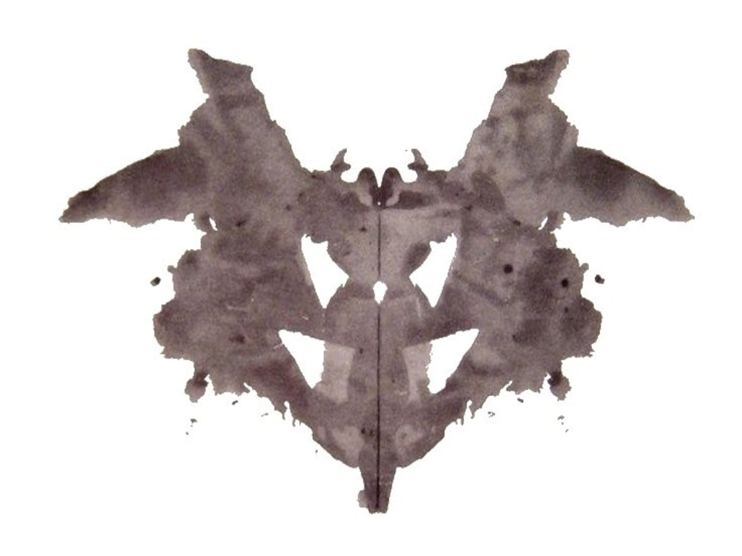
Improvement of conventional perception in stable patient with schizophrenia by add-on treatment with ipidacrine.
Margarita Morozova, George Rupchev , Laboratory of psychopharmacology FSBSI Mental health Research Center, Moscow RF,
Copyright © 2021 Margarita Morozova, George Rupchev, margmorozova@gmail.com
Introduction. Impairment of conventional perception is one of the key dysfunction in patients with schizophrenia even in absence of psychotic symptoms. (1). In the previous double-blind, placebo-controlled study, the add-on of ipidacrine to risperidone in schizophrenic patients with severe negative disorders for treatment of cognitive dysfunction showed a large positive dynamics of emotional-volitional disorders in the study group. (2). In the experiment, it was shown that ipidacrine accumulates in the cerebral cortex and hippocampus and improves cognitive functions [3].
Objective. Possibility of improvement of conventional perception by add-on treatment with ipidacrine in stable patients with schizophrenia.
Methods: 26 (13 females) patients, mean age 40.4 (SD 11.7) with episodic schizophrenia in remission, receiving stable antipsychotic therapy were included into the open label study. As add-on treatment ipidacrine was administered once per day in dosage 20 mg for two months. Positive and Negative Symptoms Scale (PANSS) was used to assess clinical symptoms and projective psychological method (Rorschach Test) (1) was used to assess conventional perception. To assess the dynamics of cognitive dysfunction, the BACS (Brief Assessment of Cognitive Function in Schizophrenia) (4) scale was chosen.
Results. The study showed that ipidacrine in a low dosage, added to standard antipsychotic treatment, was effective in relation to negative symptoms (PANSS negative subscale score before 22,4 (SD4,7) and after beginning of the study 19,7 (4,5), p=0, 001) (Fig.1). Of all the indicators of the Rorschach test, there was significant improvement in the index X+%, which is responsible for the degree of conventionality in reality recognition. The decrease in conventionality was associated with both high individualism and perceptual disorders. The value of of X+ % did not reach the standard one (70%) to the end of the study, but the improvement showed the switching from severe (52,4 (SD 12,2) to moderate (60,6 (SD10,4) impairment level (p=0,039) (Fig.2). The results of repeated testing demonstrated a statistically significant improvement in the cognitive functioning of patients only as a whole (integrative T-ball indicator) during treatment (Fig.3).
Fig.3.
Fig.1
Fig.2.
Subsale BACS | Beginning trial | End of trail | p
Verbal memory | 45,4 (15,6) | 51,8 (15) | 0,07
Work memory | 39,3 (13,9) | 44,1 (12) | ns
Motor speed | 41 (12,3) | 43,6 (12,3) | ns
Verbal fluency | 41 (12,5) | 40 (11,8) | ns
The speed of information processing | 44,5 (66,4) | 33,4 (13,7) | ns
Executive function | 41 (12,8) | 46 (16,7) | ns
Т-score | 34,2 (15,5) | 39,2 (16,5) | 0,005*
Examle: Patient K. (45 age)
Response on Visit 1:«Cerebellum…»(F-).
Response on Visit 2 (60 days): «…Bat».(Fo, X+% ↑)
Conclusion. Ipidacrine in a low dosage as add-on treatment has positive impact on conventional perception of stable patients with schizophrenia even in short-term trial.
Assanovich MA. The integrative system of psychodiagnostics by the Rorschach method. M.: Kogito-Tsentr; 2011. (In Russ.).]
Morozova MA, Beniashvili AG, Rupchev GE, Lepilkina TA, Starostin DS, Brusov OS. Effects of the anticholinesterase drug neuromidin in patients with schizophrenia with marked neurocognitive deficits. Zhurnal nevrologii i psikhiatrii imeni S.S. Korsakova. 2008;108(11):28-35. (In Russ.).]
Yoshida S., Suzuki N. Antiamnesic and cholinomimetic side-effects of the cholinesterase inhibitors, physostigmine, tacrine and NIK-247 in rats. Eur J Pharmacol. 1993;250(1):117-124. hhtps://doi.org/10.1016/0014-2999(93)90628-u
Keefe R.S., Harvey P.D., Goldberg T.E. et al. Norms and standardization of the Brief Assessment of Cognition in Schizophrenia (BACS) // Schizophrenia Research 102 (2008) 108–115.

