Slide 1

Rare and Other Valuable Metals in Coal Deposits of the Far East of Russia
Vyalov V.I.¹, Petrov O.V.¹, Larichev A.I¹, Borovik V.I.¹, Shishov E.P.¹ , Bogomolov A.H.²
¹A.P. Karpinsky Russian Geological Research Institute (VSEGEI), Russian Federation, St. Petersburg
² Moscow State University, Russian Federation, Moscow
E-mail: Vladimir_Vyalov@vsegei.ru
Cape Town, 2016

Slide 2
Speaker - Vladimir Vyalov,
Doctor of Geology & Mineralogy,
Chief Scientist
A.P.KARPINSKY RUSSIAN GEOLOGICAL RESEARCH INSTITUTE (VSEGEI),
Professor of LOMONOSOV MOSCOW STATE UNIVERSITY

Slide 3
In Russia, more than 25 large coal basins and areas, hundred coal deposits are discovered. All of them are presented on the Map of Coal Presence, Quality and Resources of Coals in Russia and on the Map of Coal Deposits of Russia on a Geological Basis.
This Maps is compiled in VSEGEI, under my management.
The Maps presents generalized characteristics of coal quality in coal basins and deposits of Russia and coal reserves/resources. Coals of Russia have different geological age and rank, mainly vitrinite composition, various quality and properties.
The explored reserves of Russian coal is 192 billion tons, brown coals – 52.3%, hard coals- 44.1% (coking coals – 20.5%), anthracites – 3.6%. The estimate coal resources – 79.79 billion tons, brown coals – 57%, hard coals- 40.2% (coking coals 12.6%), 2.8%- anthracites.
In the given Report the accent is made on Brown Coals of the Far East of Russia

Slide 4
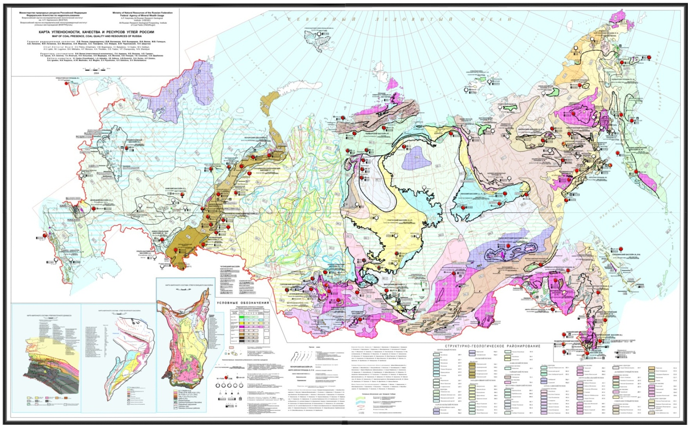
Map of Coal Presence, Quality and Resources of Coals in Russia

Slide 5
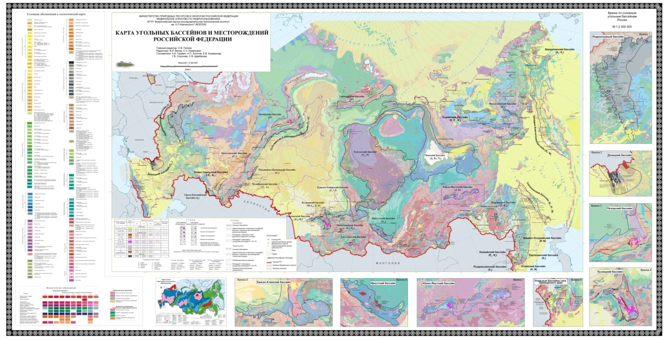
Map of Coal Deposits of Russia on a Geological Basis

Slide 6
In Russia, in the Far East, there are a great number of brown coal deposits, which host industrial concentrations of Ge, Ga, Ve, Sc, W, Sb etc., with rare metal resources of many thousands of tons. It is Cenozoic Deposits of Brown Coals.
On 34 sessions IGC in Brisbane the author did the report «COAL DEPOSITS OF RUSSIA AND THEIR RARE METAL POTENTIAL».
Data on valuable metals in coal deposits of Primorski Territory has been presented.
3 brown coal deposits with rare metals were presented (small ore deposits - Be, Sb, W, Mo etc., large - Ge "in" coal-fields):

Slide 7
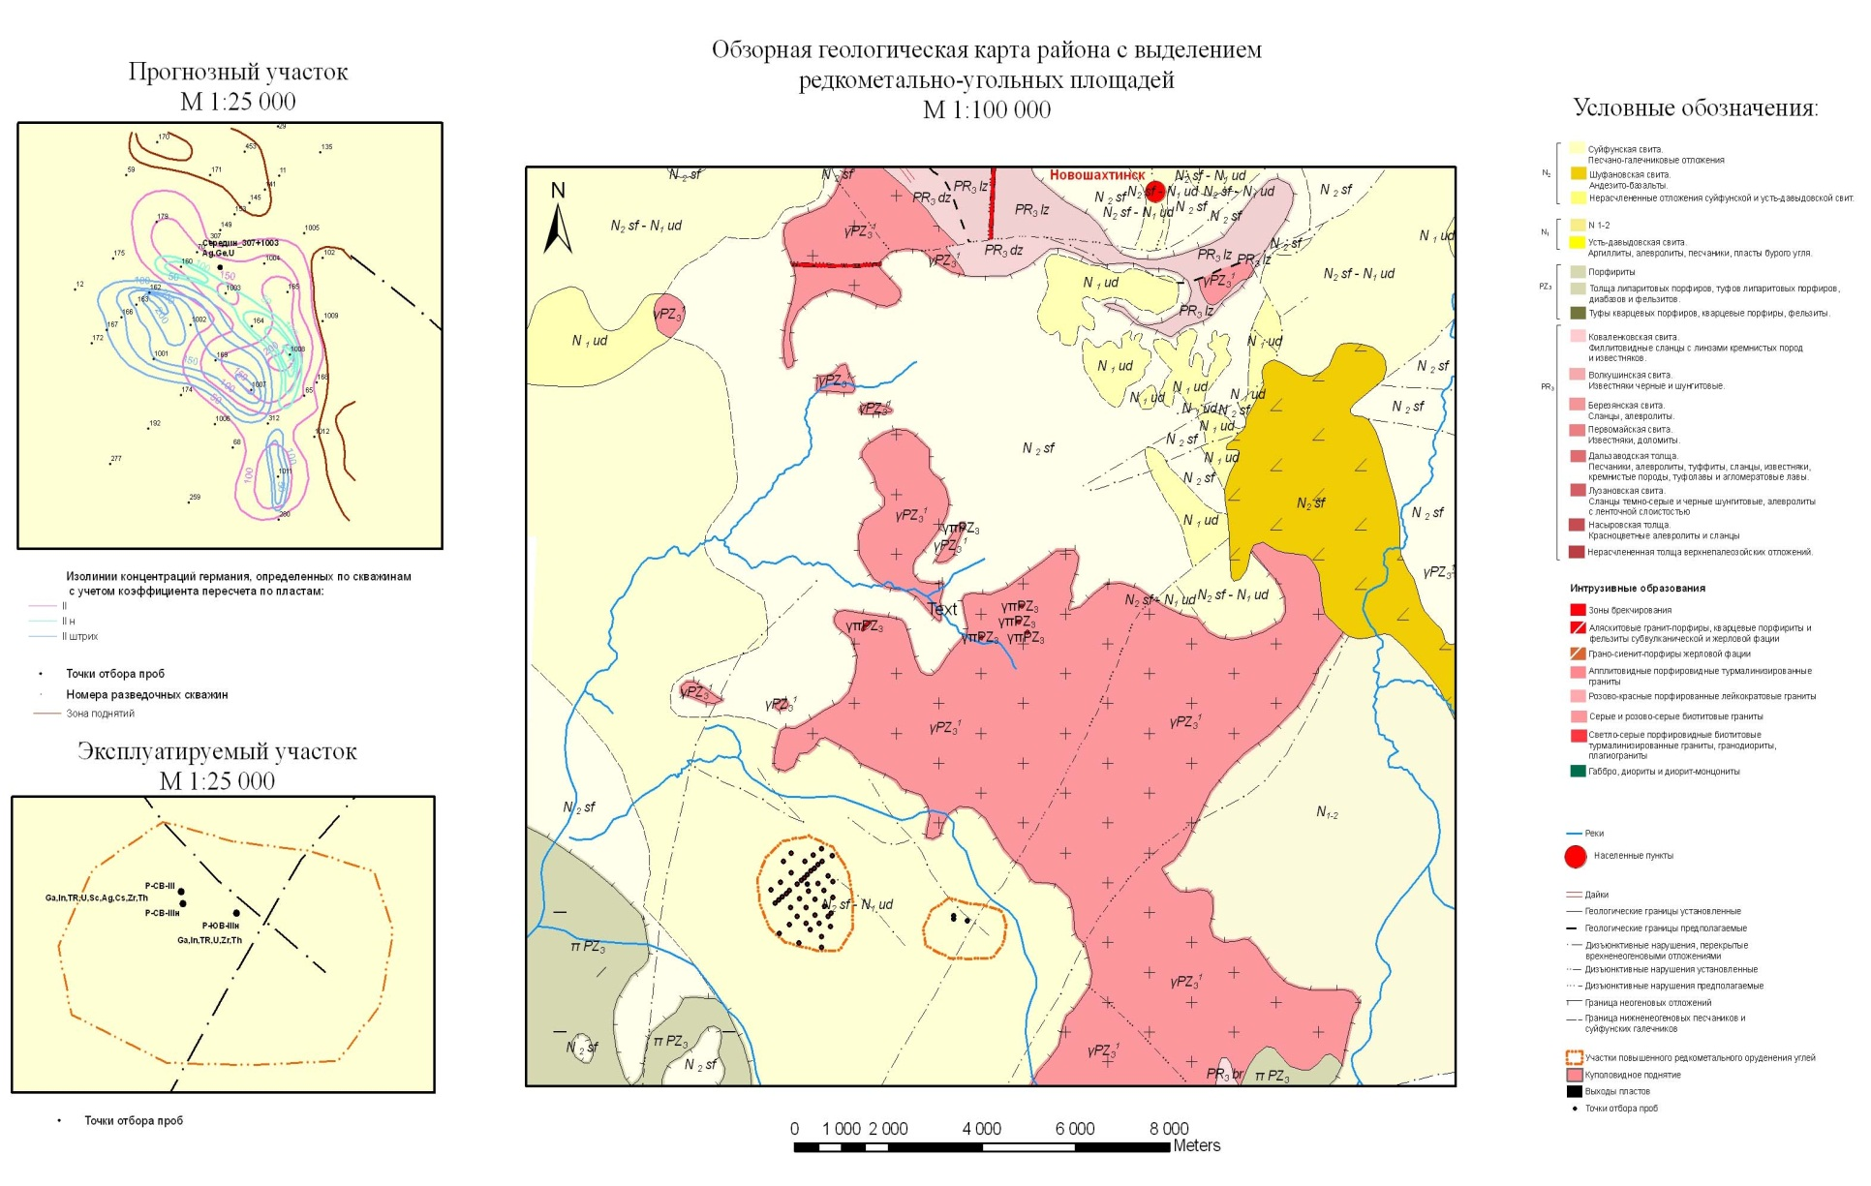
1. Rakovsk brown coal deposit with rare metals
Max. concentrations: Be – 338, Ga – 96,4, Ge -1100, Sb – 610, REE+Y – 2853, Mo – 230, In- 1,63, U- 3670 p.p.m. (in ash of coal)

Slide 8
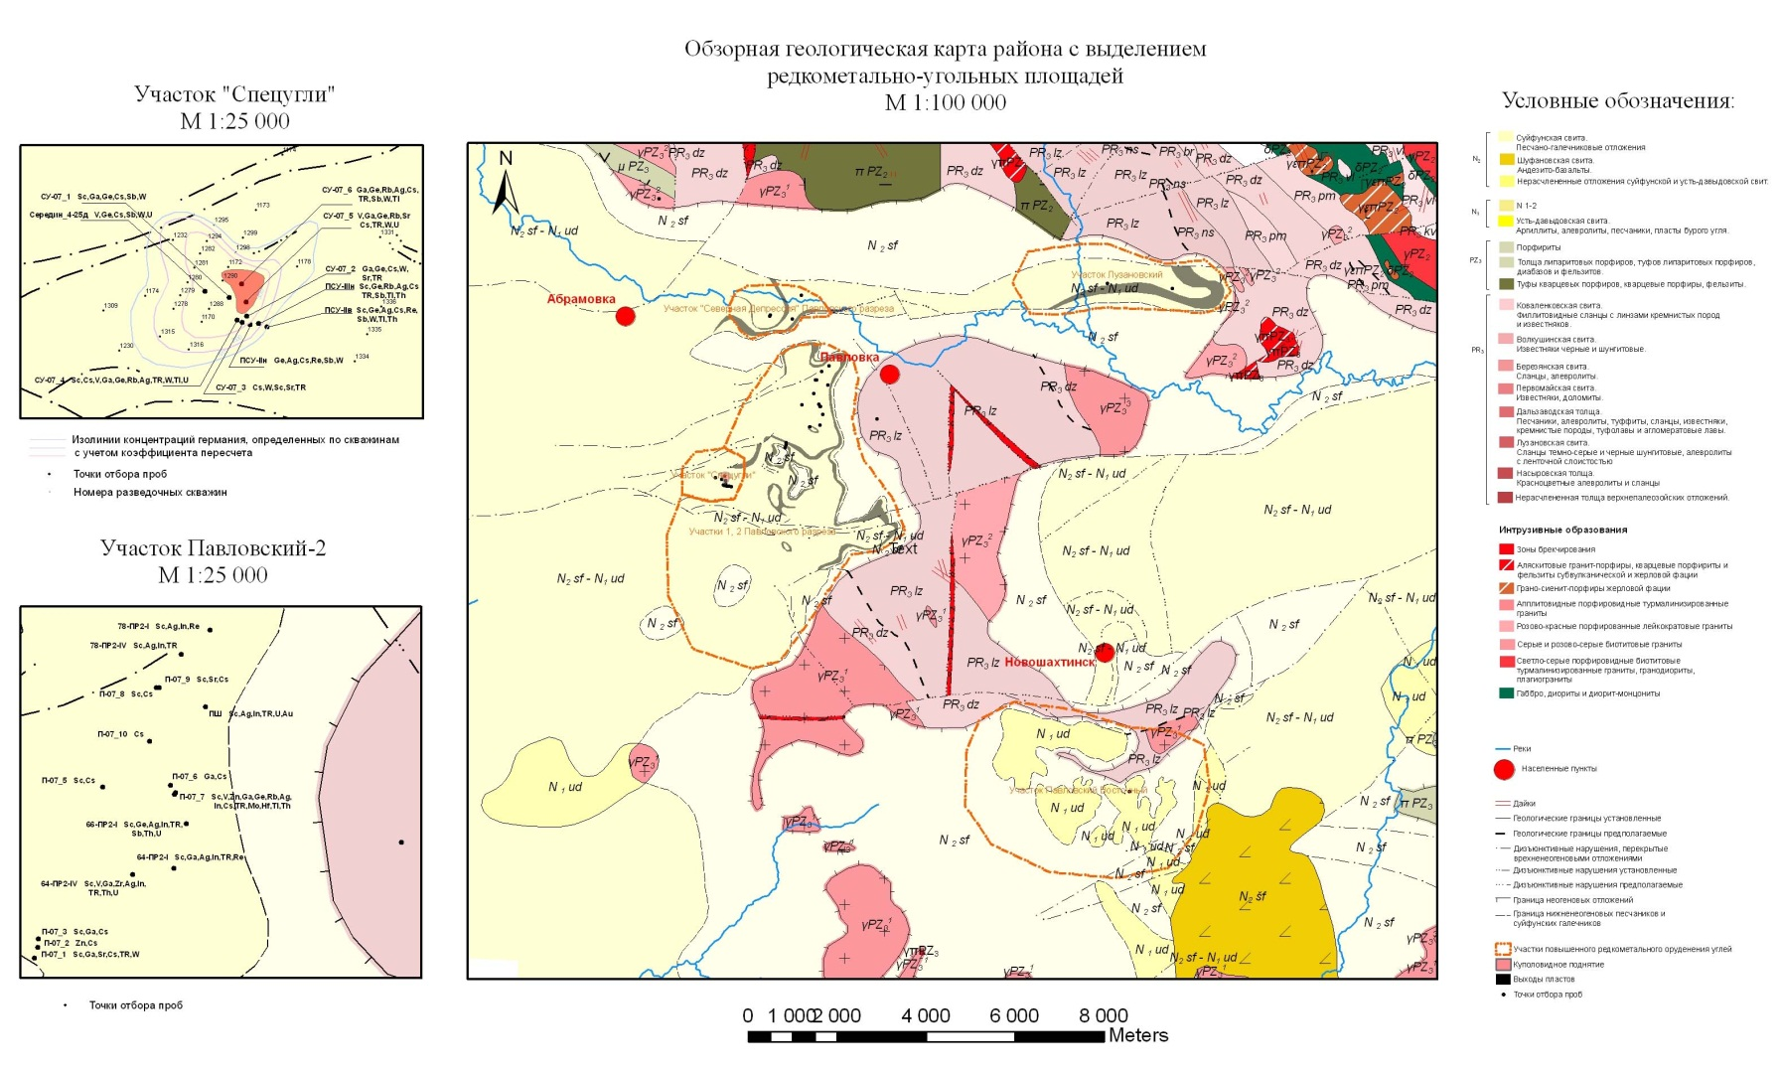
2. Pavlovsk brown coal deposit with rare metals
Ge – 580, Sb – 192,1, REE+ Y – 91,0, W – 254,2 p.p.m. (in coal substance)

Slide 9
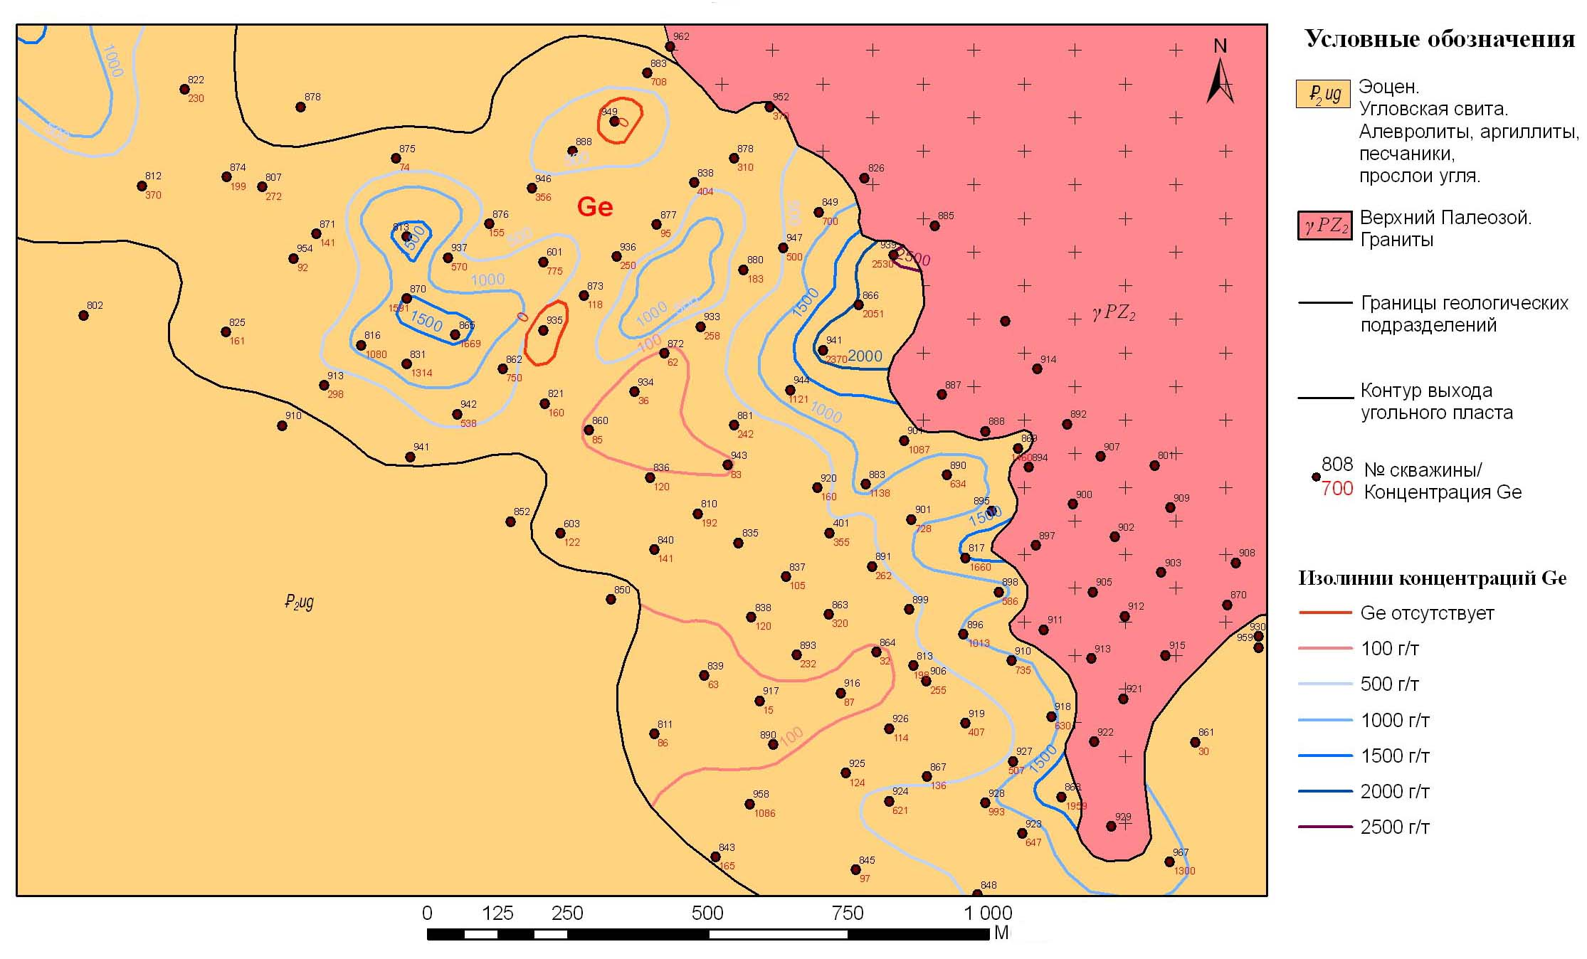
2. Shkotovsk brown coal deposit with rare metals
Ge content, ppm
0
Ge – 1484, Sb – 598, REE+ Y – 83,3, W – 341,4 (p.p.m. in coal substance)

Slide 10
Similar researches have been continued in 2012 - 2014 on coal deposits of other regions of the Far East.
The purpose of researches - an estimation of base of the valuable metals which are available in coals.
Coal deposits of unallotted fund of bowels have been chosen.
These coal deposits are located in places with a good infrastructure.

Slide 11
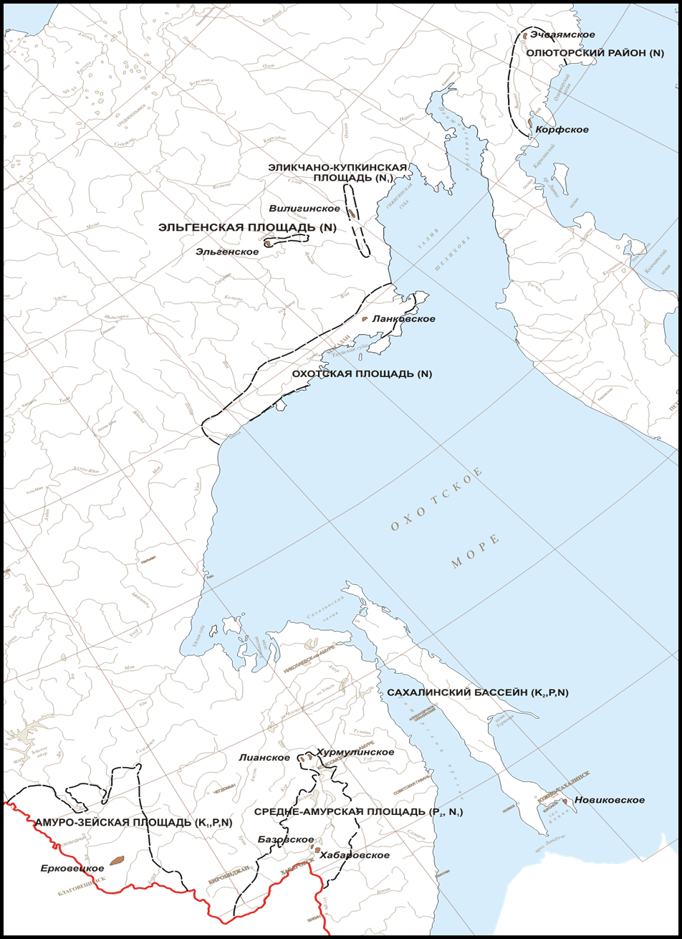
The authors studied following coal deposits of the Far East of Russia:
Kamchatka Region: Korfsky (non-licensed stock of prospects),
Echvayamsky (Losiny lot) deposits
Magadan Region:
Viliginsky (the Elikchan-Kupkinsky area),
Elgensky (non-licensed stock of prospects),
Lankovsky deposits
Amur Region:
Erkovetsky (Zapadny Prospect) deposit
Khabarovsk Territory:
Liansky,
Hurmulinsky (Hurmulinsky Prospect),
Khabarovsky, Bazovsky deposits
Sakhalin Region:
Novikovsky (Vostochy Prospect,
reserve area of the Novikovsky section) deposit

Slide 12

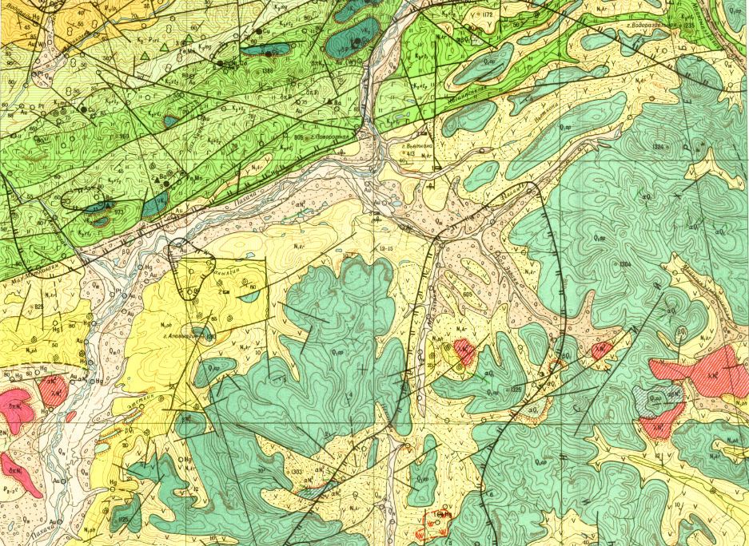
Echvayam Brown Coal Deposit, Kamchatka

Slide 13
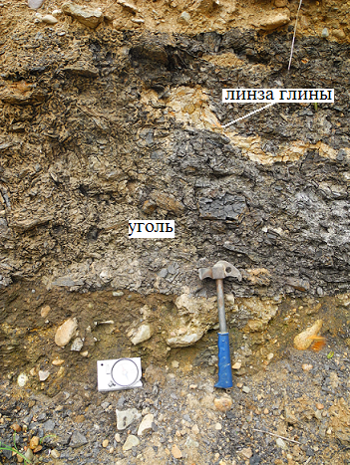
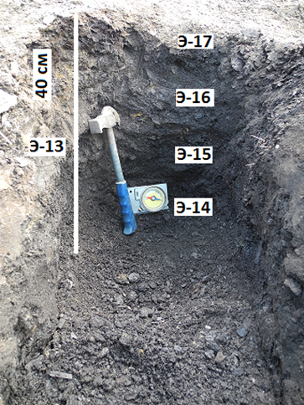
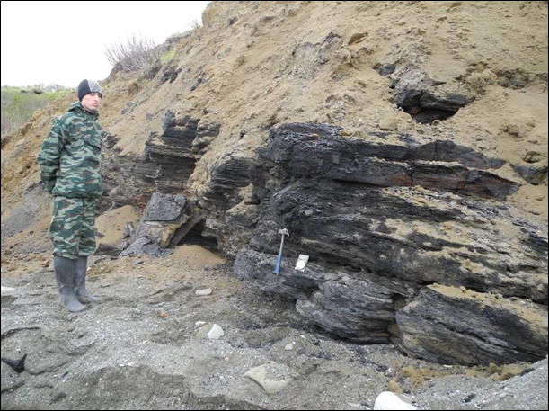
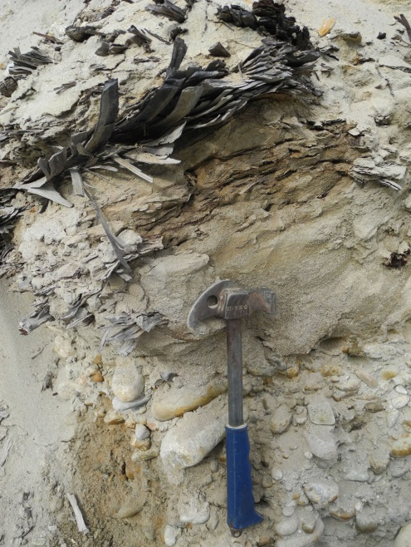
For definition of concentrations of valuable metals in it has been analysed 740 geological samples of coals which have been selected from coal deposits.
The analysis of metals has been made by a mass- spectrometry method (ISP MS) and oth.
Total analyzed more than 40 elements.
Concentration of valuable metals were compared to the maintenances resulted in the Russian State balance of reserves Ge, Ga, Sb, U, W… etc. .

Slide 14
*ICP-MS

Slide 15
Figure of Mean Contents of Trace Elements in Coals of Middle-Amur Area, Normalized to the Coal Clark*
* Ketris, Yudovich, International Journal of Coal Geology 78 (2009)

Slide 16
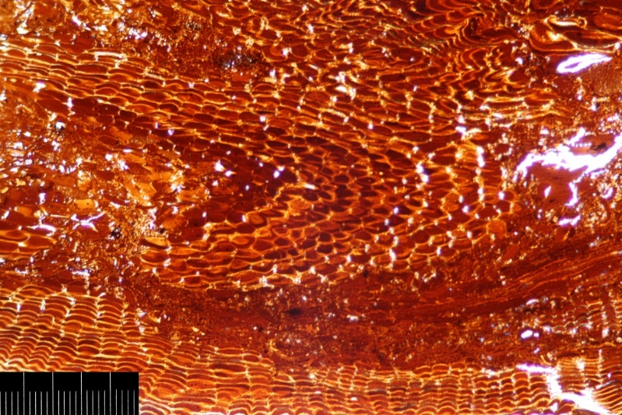
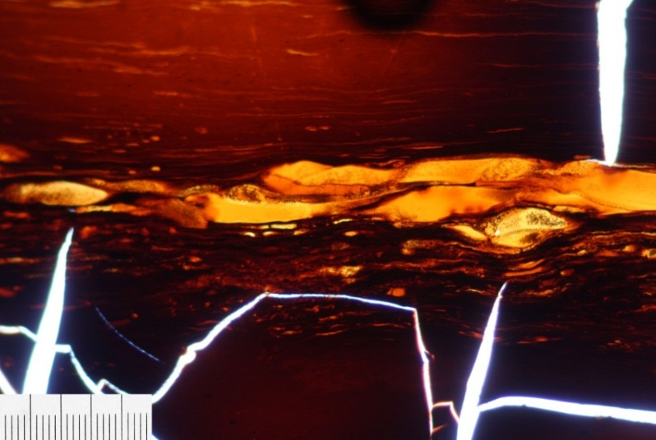
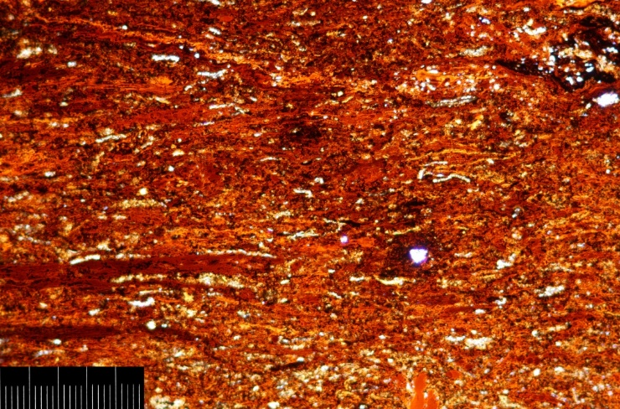
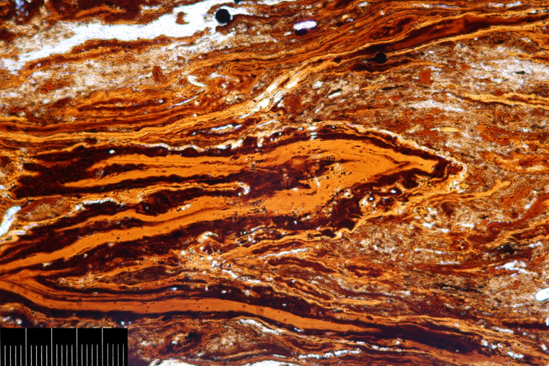
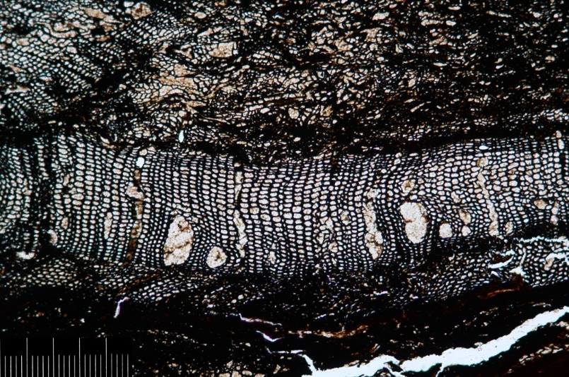
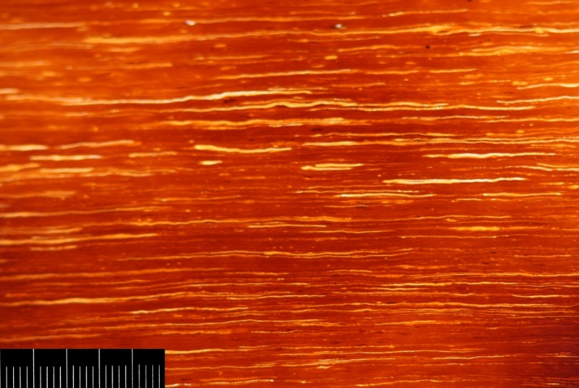
Coal macerals as concentrators of some metals
Liansky Deposit.
Humocollinite (Red-Orange),
Lens of Humotelinite (Brown),
Fusinite (Black), Fragments of Cuticles,
Microsporinite (Yellow)
Erkovetsky Deposit. Fragment of Bark Tissues - Fellinite
Novikovsky Deposit.
Collinite (Bulk),
Nest of Rezinite (Orange)
Ushumunsky Deposit.
Mineralised Humocollinite (Bulk),
Suberinite (Orange)
Erkovetsky Deposit.
Structural Inertinite (Fusinite)
Novikovsky Deposit.
Parenhinite (Red-Orange),
Cutinite (Yellow)

Slide 17
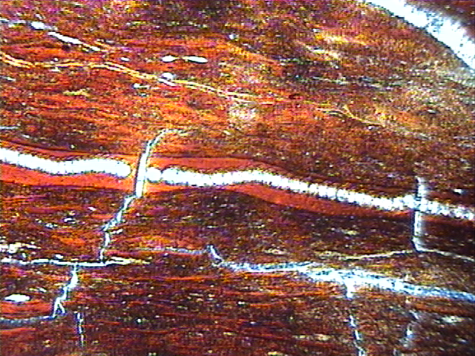
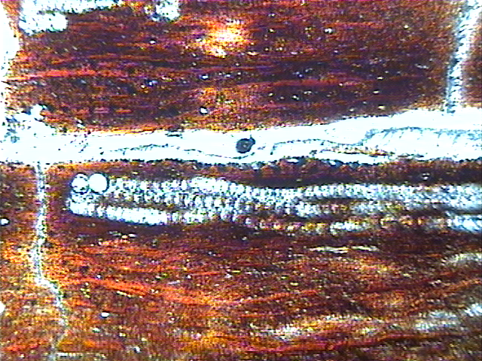
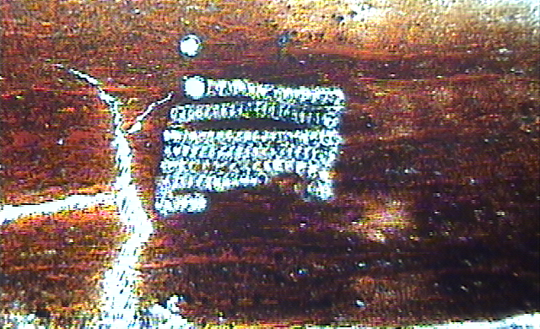
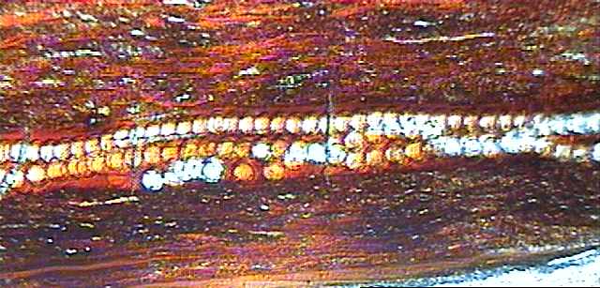
The Laser Microanalysis of Substanse of coal of Pavlovsk Deposit
Transmitted light. Chains of Laser points of approbation on:
Concentrations Ge in organic matter of this maserals makes 2370 – 6880 ppm.
The greatest maintenance Ge possesses a vitrinite.
Be to 303, Mo to 104,
W to 674 ppm
For an example:
Concentrations Ge in mineral substanse (FeS2)- 74- 86 ppm.
Be 42- 90, Mo 13- 27, W- 40 – 66 ppm
Telovitrinite
Attrito-vitrinite
Vitrinite
Attrito-vitrinite

Slide 18
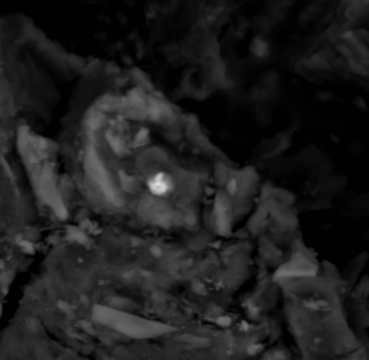
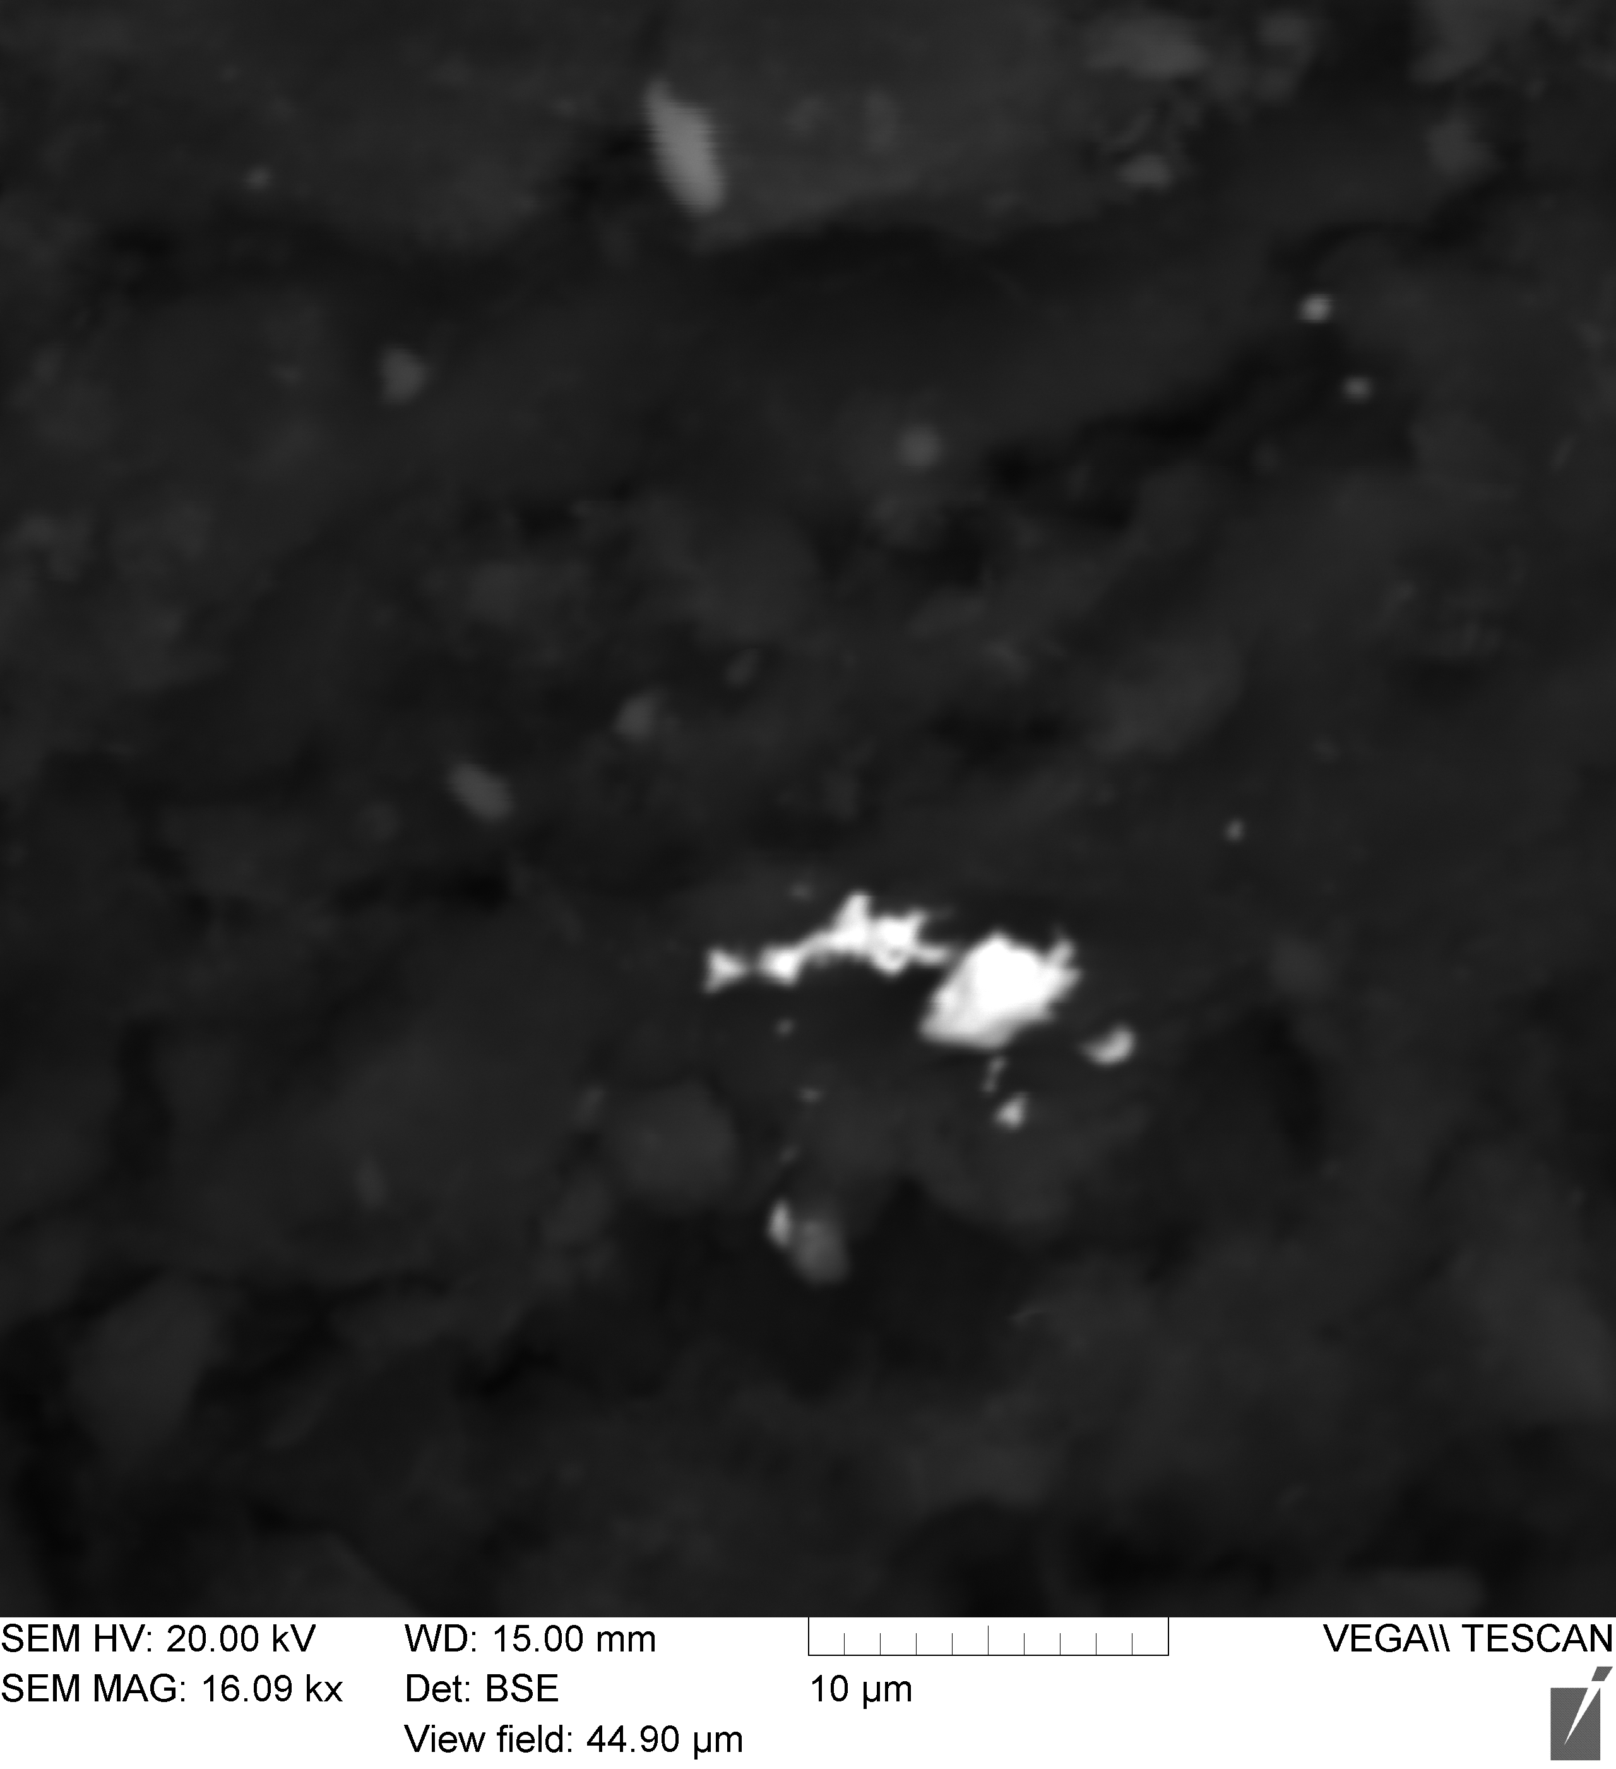
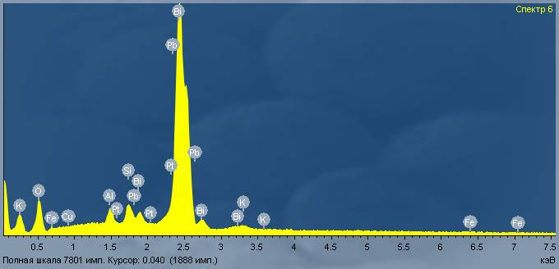

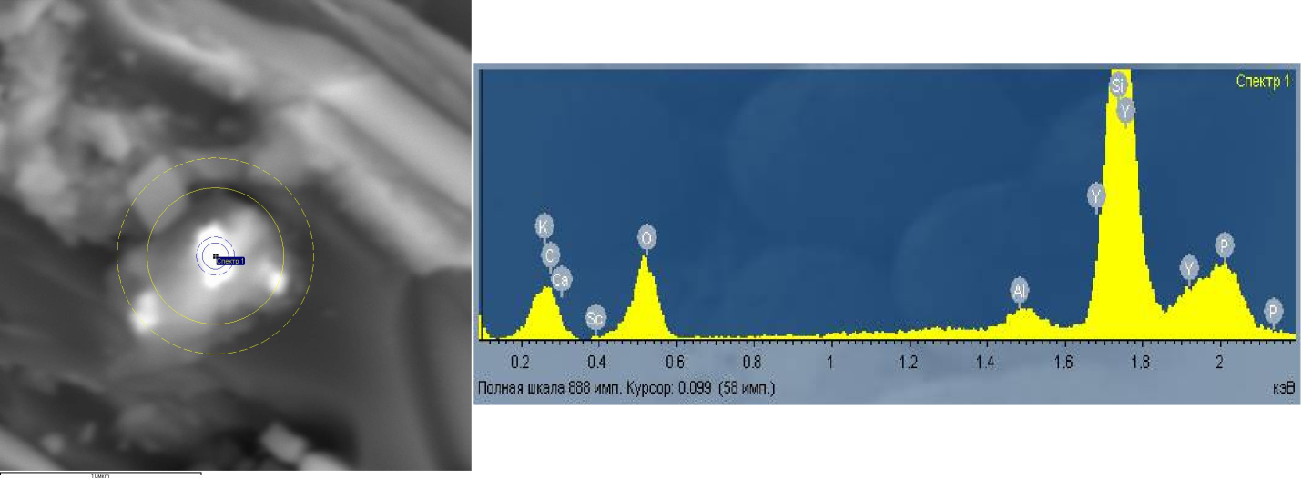
Minerals in Coals:
Platinum Inclusion in the Sample E-7С
(Elgensky Deposit)
Monazite in the Sample 5-L-Т
(Lankovsky Deposit)
Yttrium-Containing Phosphate in the Sample 5-L-Т
(Lankovsky Deposit)

Slide 19
REE Groups Content (in ppm) in Different Fractions of Coal*
(<1,3 g/cm³; 1,3-1,6 g/cm³; >1,6 g/cm³)
Dеposit | Fraction of Coal | ΣREE_{Ce} | ΣREE_{Sm} | ΣREE_{Er} | ΣREE+Y
Lankovsky | light | 222,6 | 63,03 | 59,09 | 596,72
 | middle | 248,3 | 53,08 | 41,43 | 529,81
 | heavy | 513 | 37,89 | 13,54 | 625,03
Erkovetsky | light | 164,7 | 37,58 | 19,2 | 305,18
 | middle | 105,14 | 29,28 | 17,91 | 223,03
Korfsky | light | 810,8 | 332,5 | 195,2 | 1953,5
 | middle | 975,1 | 307,3 | 140,24 | 1971,64
 | heavy | 701,1 | 220,6 | 85,39 | 1401,09
Echvayamsky | light | 441,2 | 211 | 112,04 | 1300,24
 | middle | 263,9 | 119,1 | 60,72 | 715,72
 | heavy | 110,2 | 34,56 | 13,04 | 219,4

Slide 20
3 Groups of Rare Elements in Brown Coals
Related almost exclusively to the organic part:
Ge,
Be,
W,
Mo,
Yb,
Ag, etc.
Related almost exclusively to the inorganic part:
Li,
Zr,
Rb,
Cs,
Ta,
Nb,
Tl, etc.
Related with both organic and inorganic parts:
Ga,
Sc
V,
Y,
Sr,
etc.
1
3
2

Slide 21

The Main Factors of Rare Metal Mineralization of the Cenozoic Deposits of Brown Coal
Geotectonic Factor;
Composition of Rocks of Source Area;
Facies Factor;
Substance Factor (Maceral and Ash factors).

Slide 22
The accumulation mechanism of metals in coals
Extraction and concentration of metals organic matter of Peat occurred from Peat waters.
Early diagenesis of deposits were the basic time of Ore formation of Ge and accompanying it Be, Mo, W, Sb and other metals. It is a peat stage, when connections this metals with humic acids.
Some metals were localised in ancient peat in mineral part introduced from the outside.
The Source of elements are magmatic rocks, at their aeration. It, as a rule, granites, located in immediate proximity with ancient peatbogs.
Everywhere established zone of aeration of granites to 20 m and more testifies to development at the time of ancient Peat accumulation, with formation of white clay with quartz grains. The aeration area covered hundreds and thousand sq. km.
The favorable factor of localisation of metals is small thickness coal layers (usually to 0,5-0,6 m) .
Thus, in paleogene - a neogene in Far East, in parallel with Peat formation and contacting it, there was a process ore sedimentary - localisations in ancient peatbogs with ores of rare and valuable metals.
Ore formation is obliged to presence of organic substance, and process of concentration of metals by it in chemical interaction and sorption.

Slide 23
Ore-Forming Mechanisms in Coal Basins
Lithogenic
Ionogenic
Polygenic
Terrigenous
Tuffogenic
Syngenetic
Diagenetic
Epigenetic

Slide 24

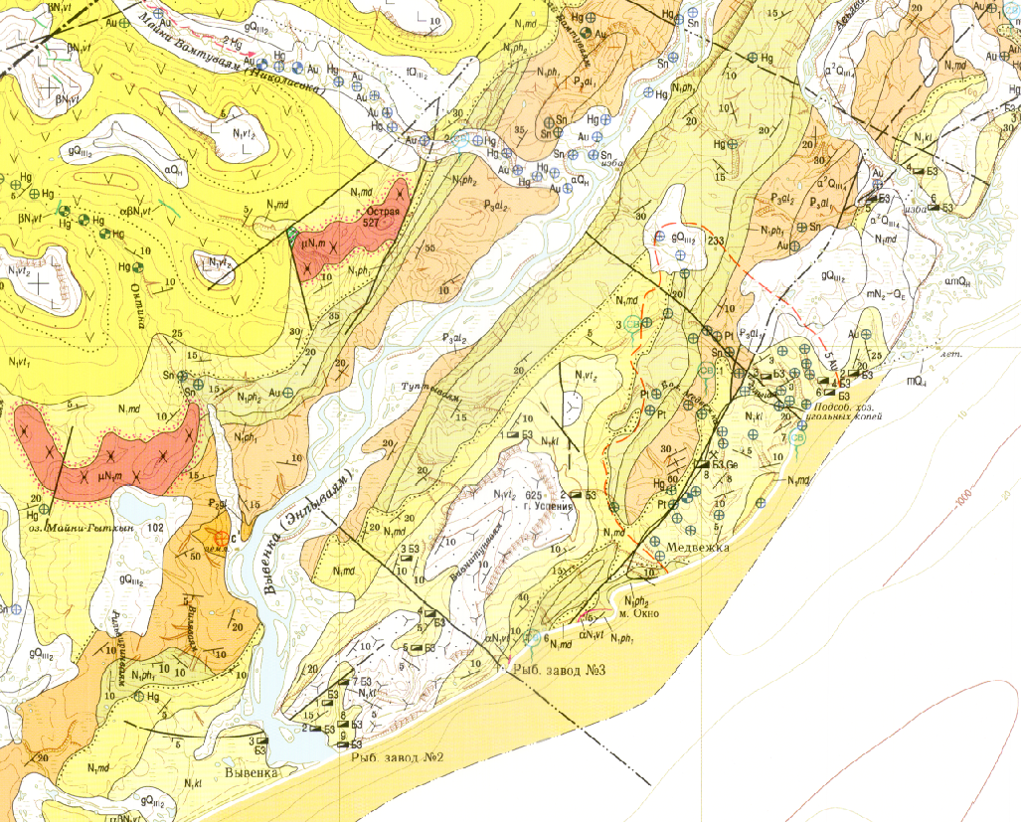
Metals in coals as the indicator hidden Ore of PGE- Au
Fragment of the state geological card of scale 1:200 000; Sheets P-58-XXXIV, O-58-IV
Gold aura
Coals of Кorf deposit:
Au to 0,03 g/t in coal;
Pt to 0,03 g/t in coal;
Pd до 0,23 g/t in coal.
Perhaps, in territory of the Magadan area around Elgensky and Viliginsky coal deposits there is an unknown deposit of platinum metals

Slide 25
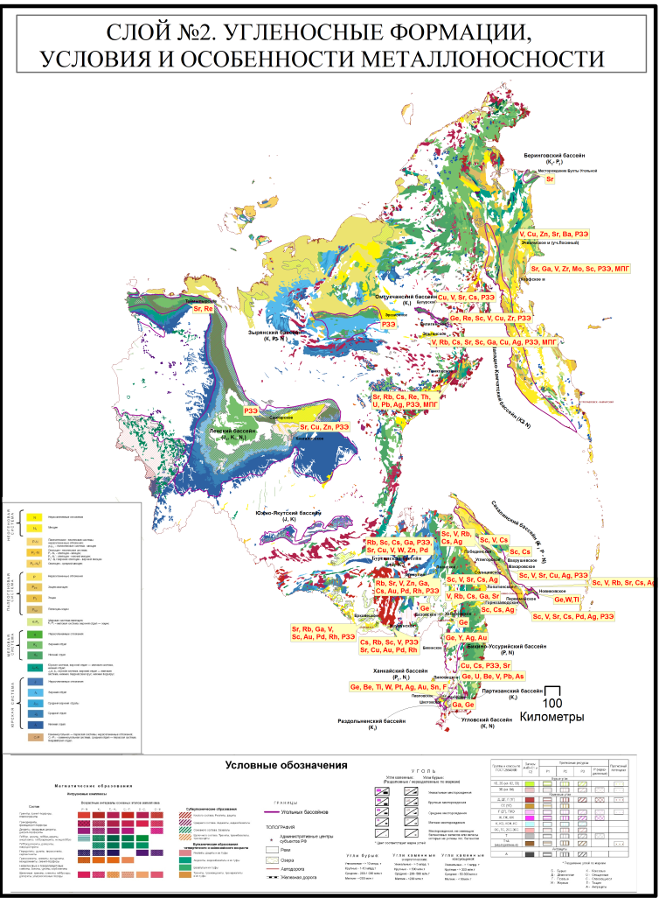
Layer 2. Coal-bearing formations, specification of metal content
As result of studying, in VSEGEI has been compiled at a scale of 1:2,500,000 the GIS map with a database on metal contents in coals of the Far East. This Map accompanied by a set of graphic materials characterizing coal deposits of the Far East
Layer 2: Coal-bearing formations,
specification of metal content
Contained Information:
quality of coals,
prognosticated resources of coal deposits,
geological age of coal-bearing formations,
composition of rocks of source area,
specification of metal content.

Slide 26
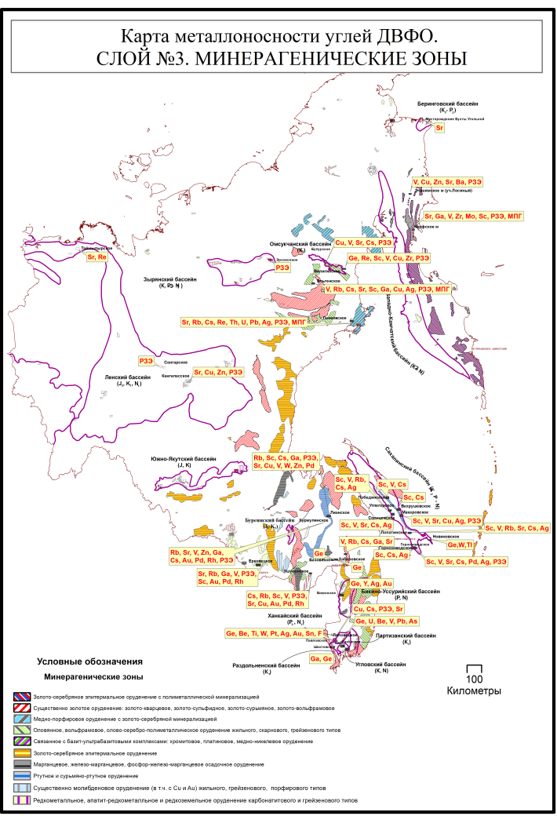
Layer 3. Minerageny
GIS map with a database on metal contents in coals of the Far East accompanied by a set of graphic materials characterizing coal deposits of the Far East Federal Area has been compiled at a scale of 1:2,500,000
Layer 3. Minerageny
Contained Information:
mineragenous zones,
geochemical specialization,
number of metals and their content in coals.

Slide 27
Rare metal resource potential of coals of Far East Federal District (the non-licensed deposits)
This metal resource of coals has been assessed according to categories of prognosticated resources («Р₃» and «Р₂» аccording to Russian classification).
In 12 studied coal deposits, the amount of rare metals prognosticated resources of category Р₂ is as follows:
Ge – 7.18 thousand tons, Sc – 11.98 thousand tons, Ga – 10.94 thousand tons, Rb₂O – 40 thousand tons, SrO – 137 thousand tons, Cs₂O – 3.6 thousand tons, ZrO₂ – 36.3 thousand tons, REE+ Y – 212.8 thousand tons.
Category Р₃: Ge – 9.8 thousand tons Sc – 14.4 thousand tons, Ga – 16.4 thousand tons, Rb₂O – 46.3 thousand tons, SrO – 125.7 thousand tons, Cs₂O – 9.16 thousand tons, ZrO₂ – 135.6 thousand tons,
REE+ Y – 266.18 thousand tons.
PGM of category Р₂ amount to 15.1 tons and those of category Р₃, 24.4 tons.

Slide 28
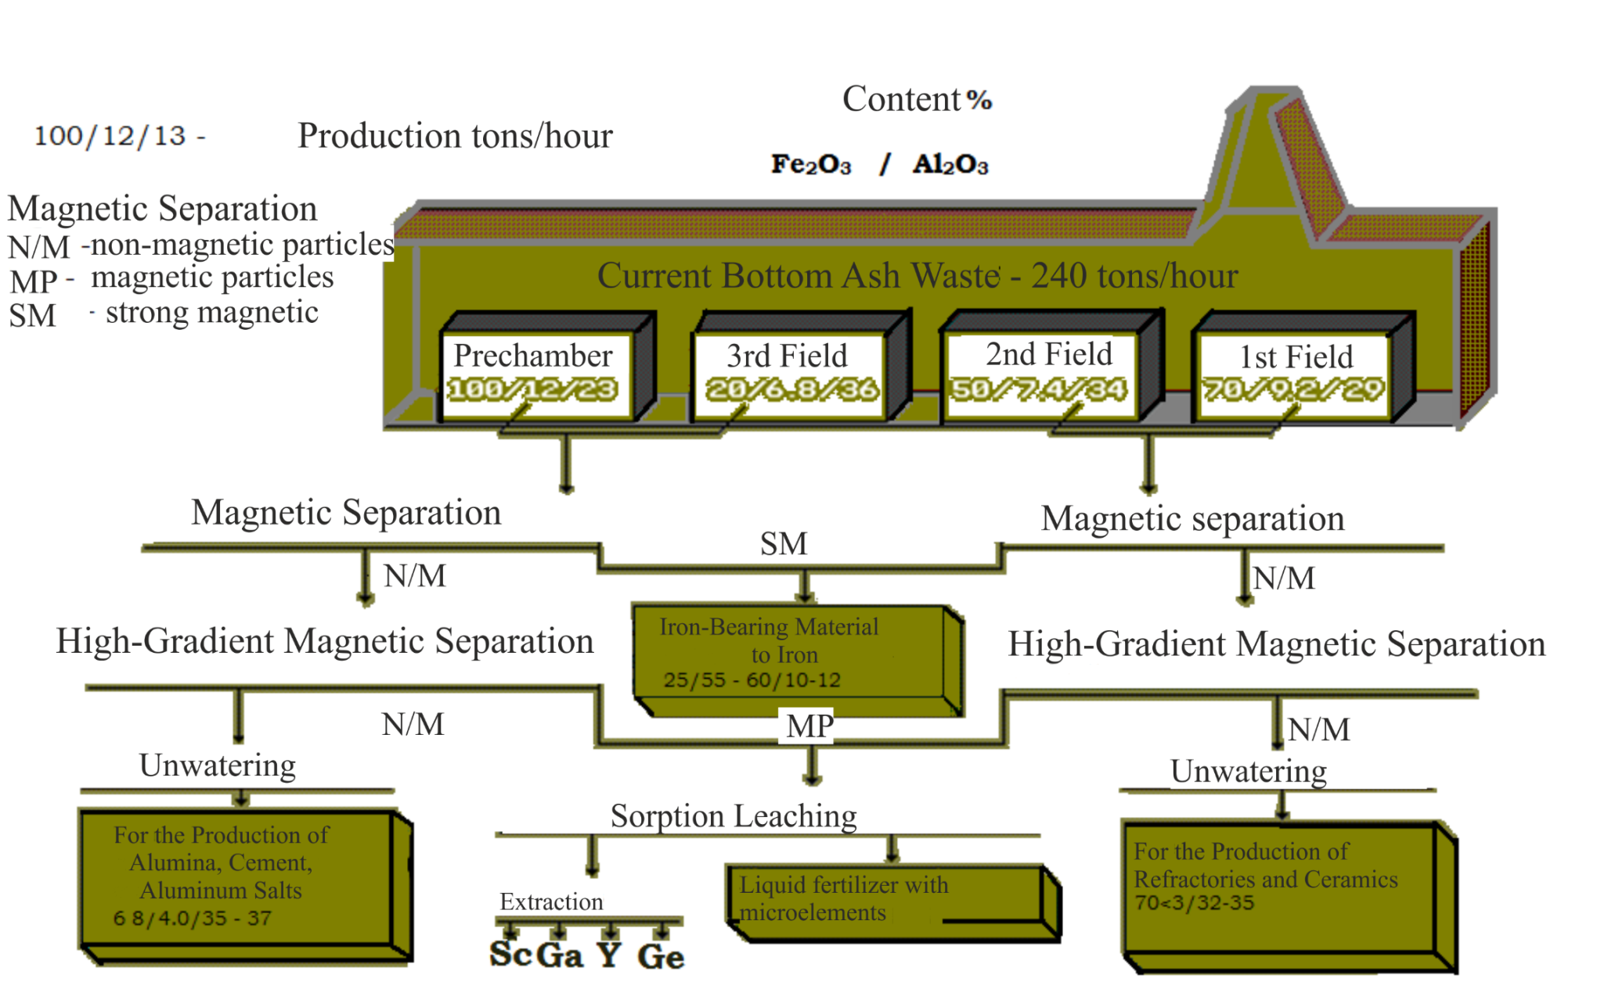
According to opinion All-Russian Research Institute of Chemical Technology (FSUE ARRICT), from coals (ashes) probably extraction of such metals, as Sc, Ga, Y (+REE), except Ge.
Principal Technological Scheme of Processing of Ash Waste of Coal with Rare-Metal Extraction

Slide 29
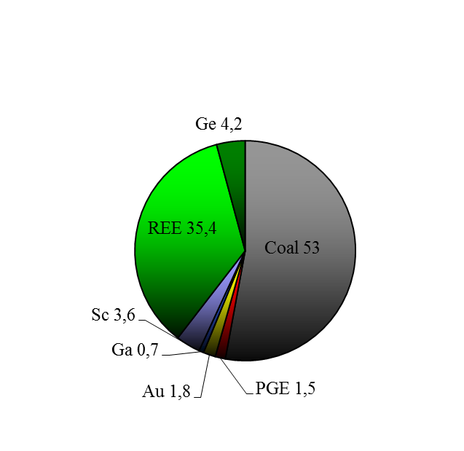
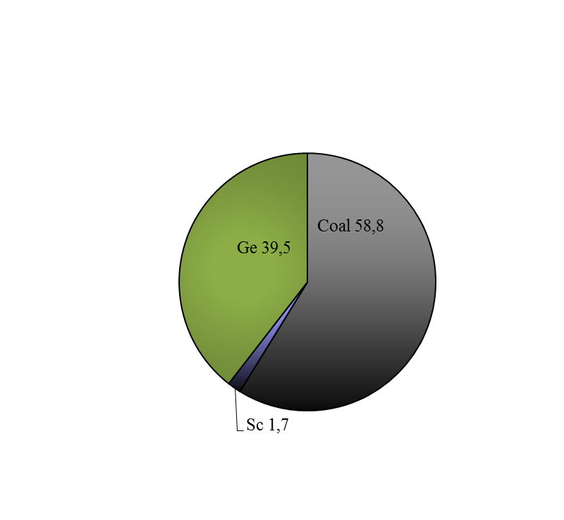
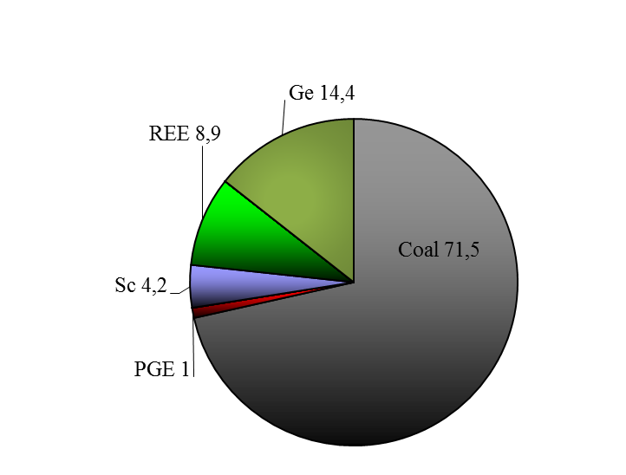
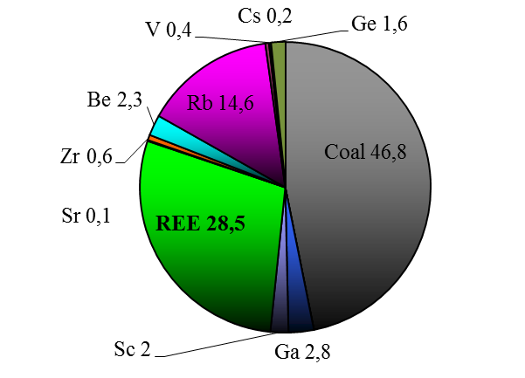
Economic-Geological Evaluation the Non-Licensed Coal Objects of the Far East With Their Rare Metal Potential
Structure potential stocks of cost of coal and resources of valuable metals of the Hurmulinsky, Erkovetsky, Korf, Novikovsky deposits (from left to right)

Slide 30
The account of rare and other valuable metals in the coal allows estimating more complete real cost of coal deposits, their profitability and investment appeal.
Accounting and organization of accompanying mining of some rare and other valuable metals from metal-bearing coal deposits will allow essential increase in economic efficiency of the development of these coal deposits.
As a result of the study, a some coal deposits of the Far East as complex deposits of a new type: rare metal-coal deposits and not only as raw sources of coal.
Prognostic resources of Ge, REE, Sc, Ga, Rb, Cs, Sr, PGE as well as other metals in the studied deposits testify to a new considerable mineral-raw base of rare metals and other valuable metals in brawn coal deposits of Far East of Russia.

Slide 31

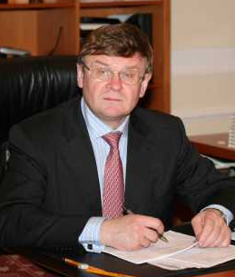
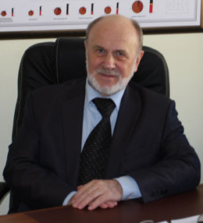



Thank you for your attention!
Dr. Vyalov Vladimir, VSEGEI,
Chief Scientist;
MSU, Professor
Dr. Oleg Petrov, VSEGEI,
Director General
Larichev Andrey, PhD, VSEGEI,
Deputy General Director
Borovik Vitaly, VSEGEI
Head of Department
Shishov Evgeny, VSEGEI,
Researcher, Postgraduate
Bogomolov Alexander, MSU,
Docent

