Slide 1
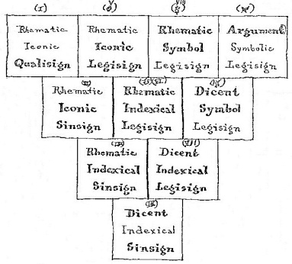
Lomonosov Moscow State University
Branch in Sevastopol
Yurii L. Sytko, Ekaterina I. Sorokina
Common Features of Charles S. Peirce’s Theory of Signs and Aristotle’s Categories through J.Pacius’ Table of Predicabilia
Sevastopol 2016

Slide 2
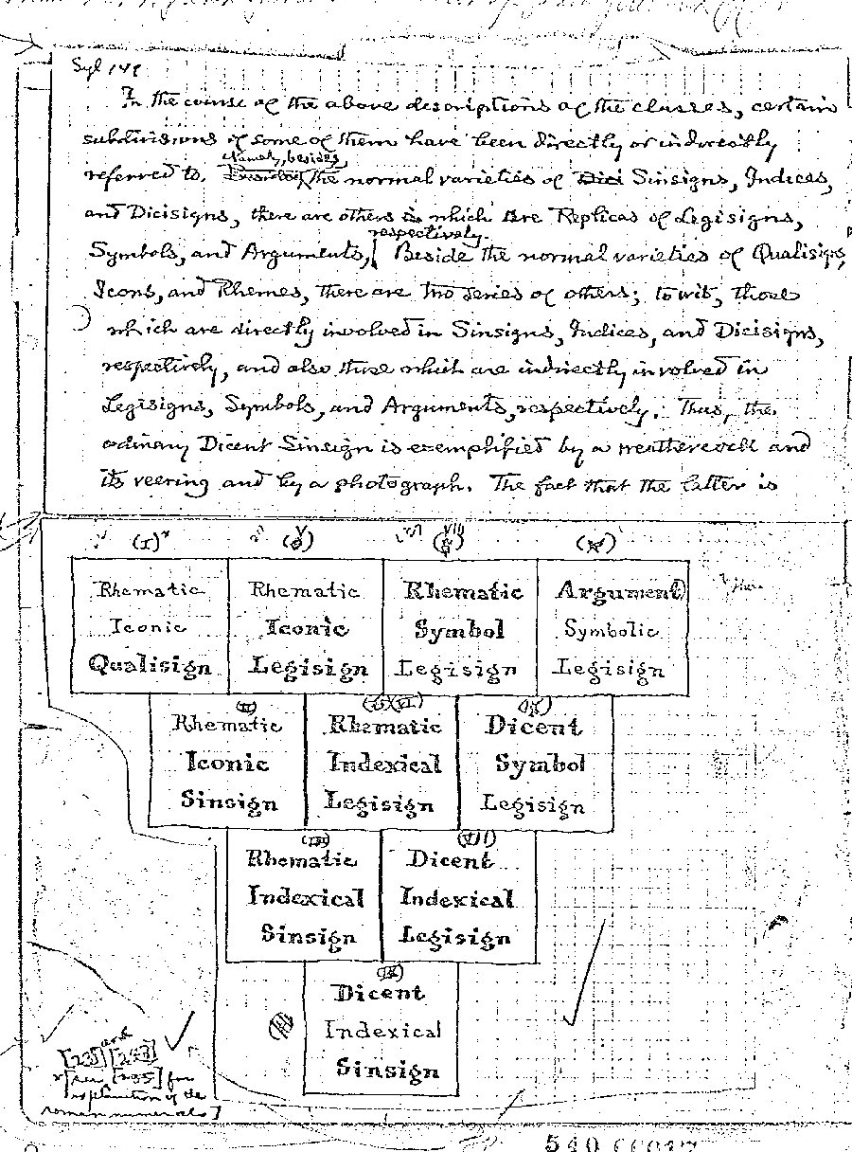
Indiana University–Purdue University Indianapolis (IUPUI)
Peirce Online Manuscripts, Graphics, Marginalia, & Letters
http://www.iupui.edu/~arisbe/digitized.HTM
http://www.iupui.edu/~arisbe/backgrnd/MS540-17.jpg

Slide 5
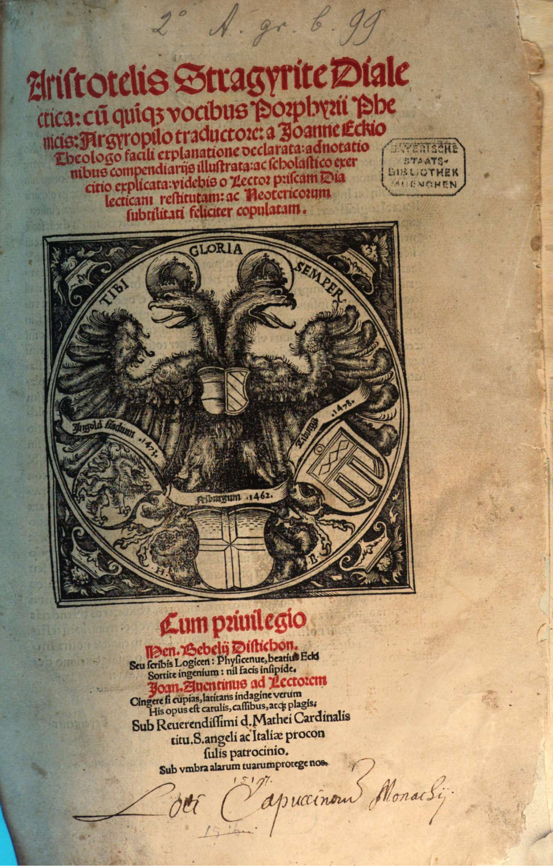
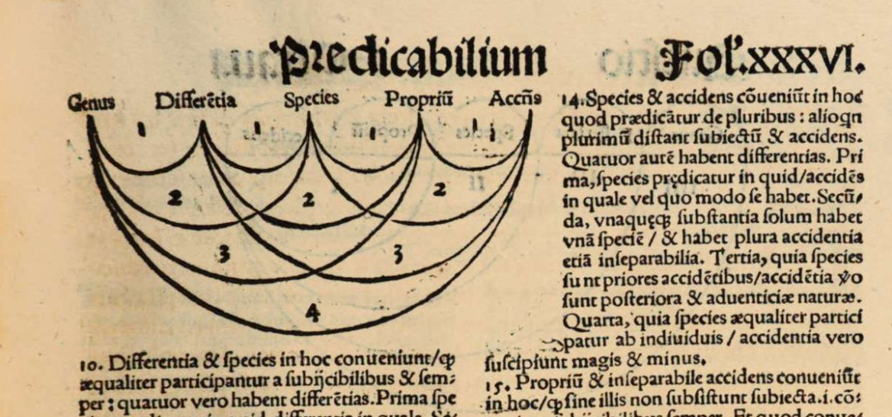
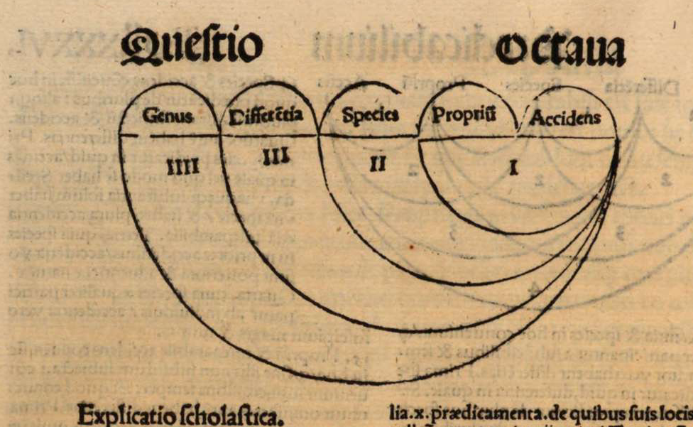
Aristotelis Stragyrite Dialectica: cu[m] qui[n]q[ue] vocibus Porphyrii Phenicis: Argyropilo traductore: a Joanne Eckio Theologo facili explanatione declarata: adnotationibus compendiarijs illustrata: ac scholastico exercitio explicata ... / Aristoteles, Porphyrius, Johannes Eck, Johannes (Argyropulus). – Augustae Vindelicorum: Miller, 1517.– 190 fol.

Slide 6
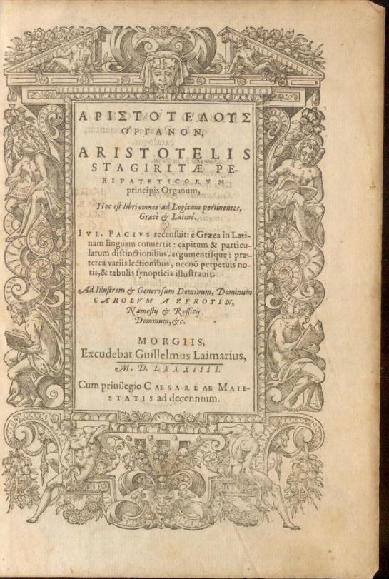
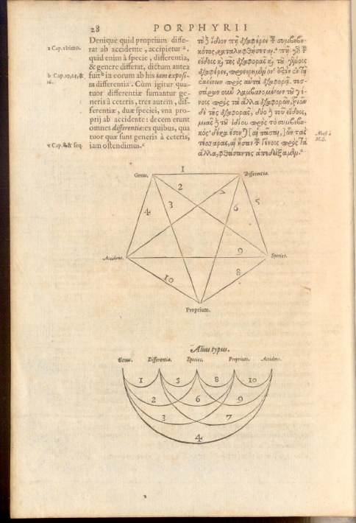
Aristotelous organon : Aristotelis stagiritae peripateticorum principiis Organum, hoc est, libri omnes ad Logicam pertinentes, graece et latine ... Accessit eiusdem Pacii in universum Organum Commentarius Analyticus, nunc primum in lucem editus. S. l.: Apud Heredes Andreae Wecheli, Claudium Marnium & Iohan. Aubrium, 1597, 895 p.

Slide 7
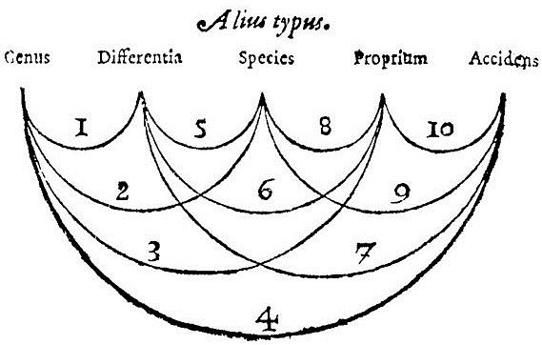

Slide 9
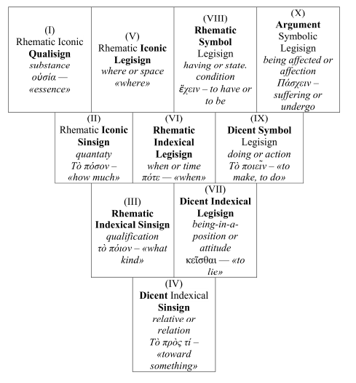
Substance (οὐσία, ousia, essence or substance).^{[6]} Substance is that which cannot be predicated of anything or be said to be in anything. Hence, this particular man or that particular tree are substances.
Quantity (ποσόν, poson, how much). This is the extension of an object, and may be either discrete or continuous. Further, its parts may or may not have relative positions to each other.
Qualification or quality (ποιόν, poion, of what kind or quality). This determination characterizes the nature of an object. Examples: white, black, grammatical, hot, sweet, curved, straight.
Relative or relation (πρός τι, pros ti, toward something). This is the way one object may be related to another. Examples: double, half, large, master, knowledge.
Where or place (ποῦ, pou, where). Position in relation to the surrounding environment. Examples: in a marketplace, in the Lyceum.
When or time (πότε, pote, when). Position in relation to the course of events. Examples: yesterday, last year.
Being-in-a-position, posture, attitude (κεῖσθαι, keisthai, to lie). The examples Aristotle gives indicate that he meant a condition of rest resulting from an action: ‘Lying’, ‘sitting’, ‘standing’. Thus position may be taken as the end point for the corresponding action.
Having or state, condition (ἔχειν, echein, to have or be). The examples Aristotle gives indicate that he meant a condition of rest resulting from an affection (i.e. being acted on): ‘shod’, ‘armed’.
Doing or action (ποιεῖν, poiein, to make or do). The production of change in some other object (or in the agent itself qua other).
Being affected or affection (πάσχειν, paschein, to suffer or undergo). The reception of change from some other object (or from the affected object itself qua other).

Slide 10
?
?
?
?
?

