Slide 1
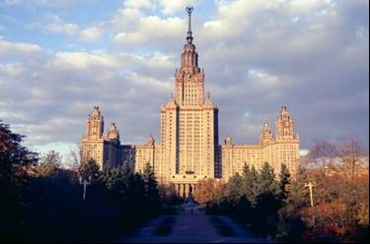
N.TUMEL, L.ZOTOVA,
N.KOROLEVA, S.DEDYUSOVA
M.V. Lomonosov Moscow State University, Faculty of Geography, Russia ntumel@mail.ru; zotlar@mail.ru; nkor65@mail.ru; alnus@mail.ru
CRYOLITHOZONE LANDSCAPES AS AN OBJECT OF ANTHROPOGENIC IMPACTS

Slide 2
ANTHROPOGENIC IMPACTS
material-energy
violation of plant, snow and water skin
terrain and soils changing
mechanical
modifying heat exchange surface and cut
reset technogenic waters
thermal
pyrogenic
acid rains
oil & gas pollution
technological waste
chemical

Slide 3
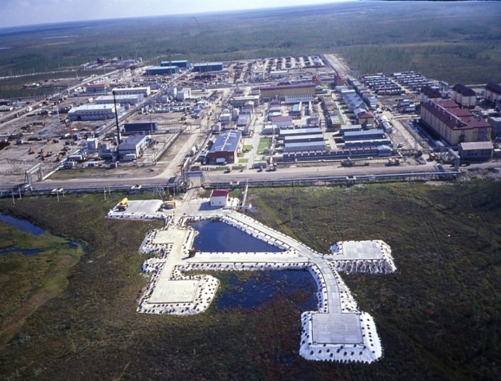
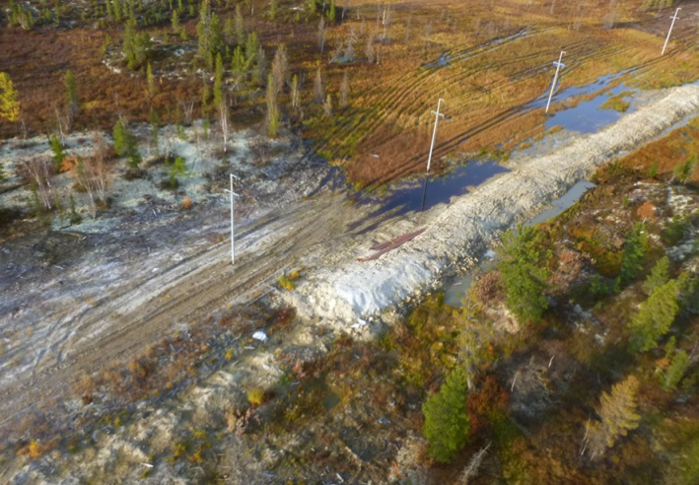
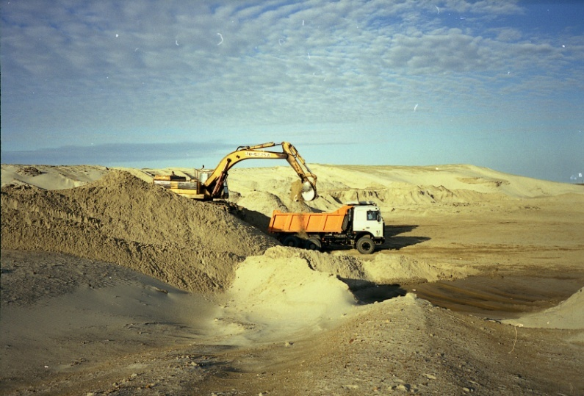
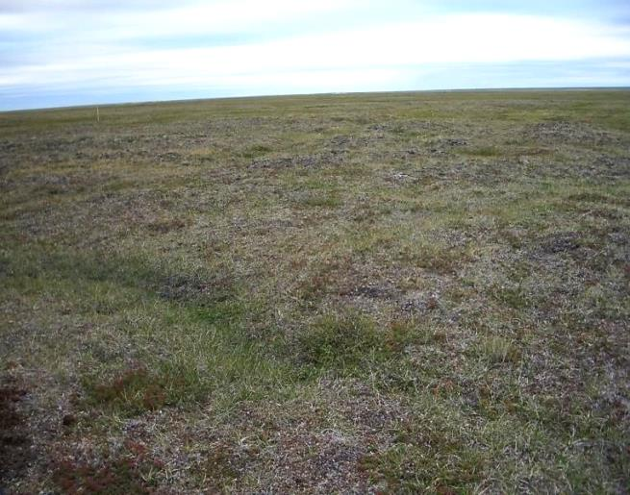
Linear and areal structures of oil-gas complex
Sand quarries
Deer pastures digression

Slide 4
Factors intensifying cryogenic processes
FACTORS INFLUENCE ON CRYOGENIC PROCESSES | PERMAFROST |  |  | VEGETATION
 | Ice content & types of ground ice | Annual mean ground temperature, °C | Dissemiination character | Protective properties | Self healing vegetation
weak | Less 0,1 | Below 10 | Rare island | The аrctic tundra – weak | The аrctic tundra – bad
moderate | 0,1–0,2 | –5…–10 | Island | Typical tundra – moderate | forest-tundra – moderate
average | 0,2–0,4 Epigenetic massive vein ice | –3…–5 0…+2* | Massively island | South tundra – good | Taiga – good
strong | 0,4–0,6 massive vein ice, pingo ice | –3…–1 | Intermittent | forest-tundra and taiga – significant | Tundra – significant
very strong | more 0,6 massive vein & ground ice pingo ice | 0…–1 | Solid | Marsh landscapes – the greatest | Marsh landscapes – the greatest

Slide 5
Cryogenic processes potential intensification
Notes:
Very strong – Yamal & Gydan peninsula (Westen Sibiria); orthern Yakutia

Slide 6
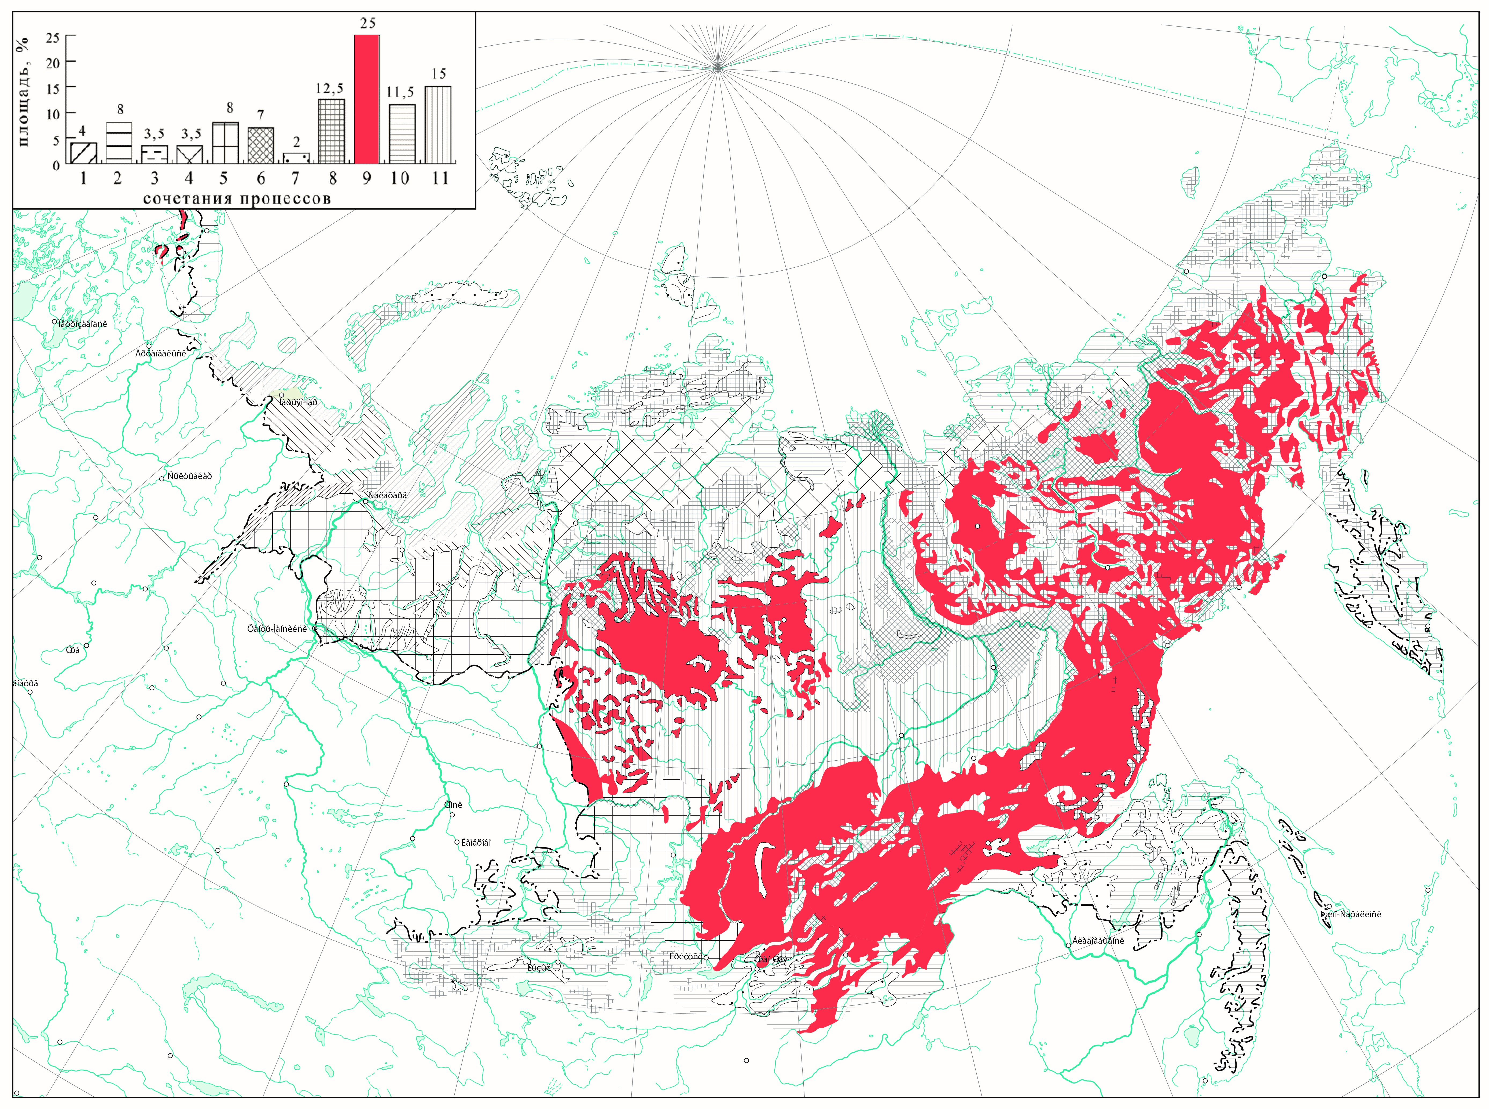
The first group of processes combinations
Thermokarst, thermoerosion, frost heaving, icing formation,rock stream
Midlands & lowlands, slight mastering, small environmental hazard

Slide 7
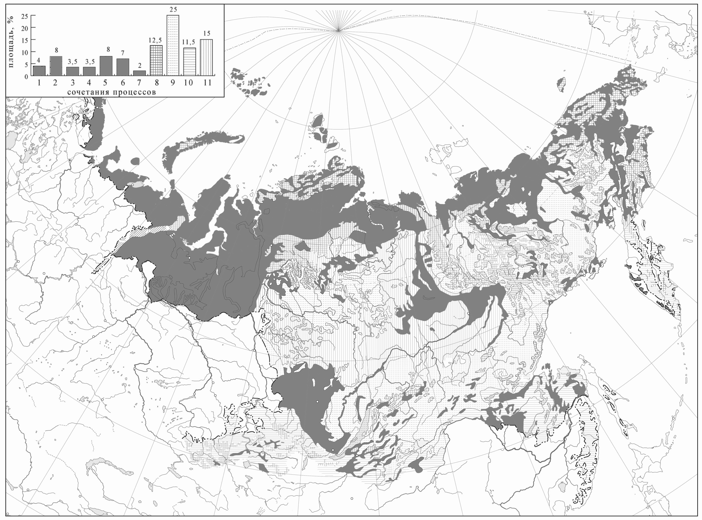
The third group of processes combinations
Thermokarst, thermoerosion, thermoabrasion, frost cracking, frost heaving, icing formation
Plains, intensive economic development, high ecological risk

Slide 8
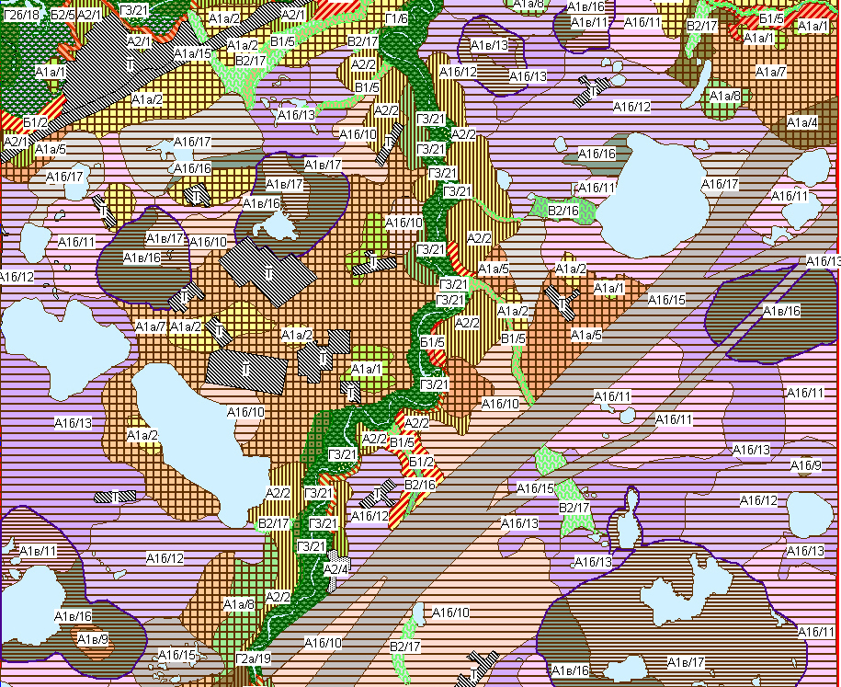
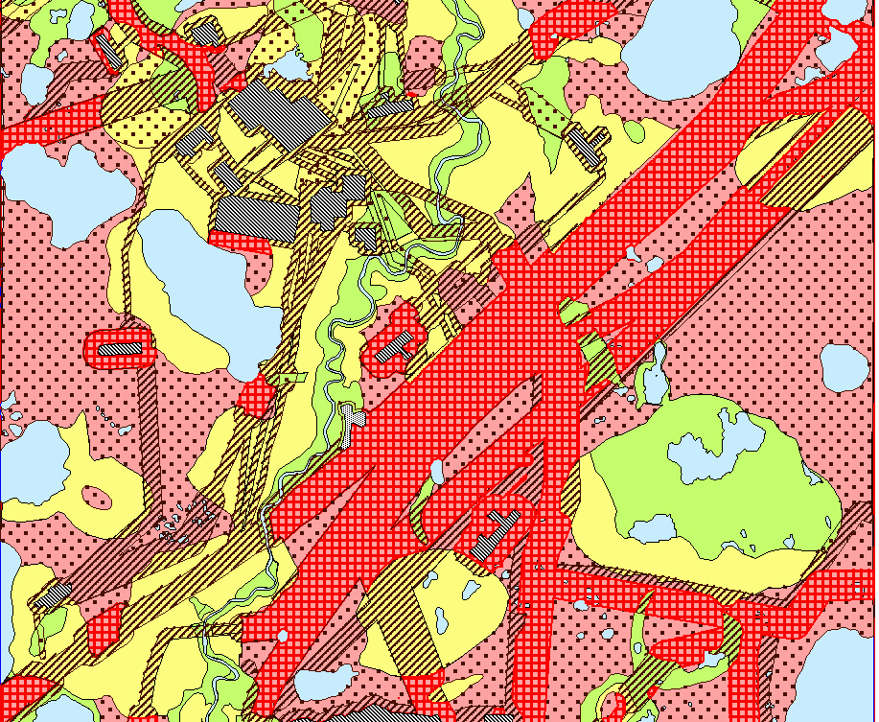
Тhe geoecological situations map for the Jubiley field
Landscapes
Масштаб 1:25 000
Тhe geoecological situations map

Slide 9
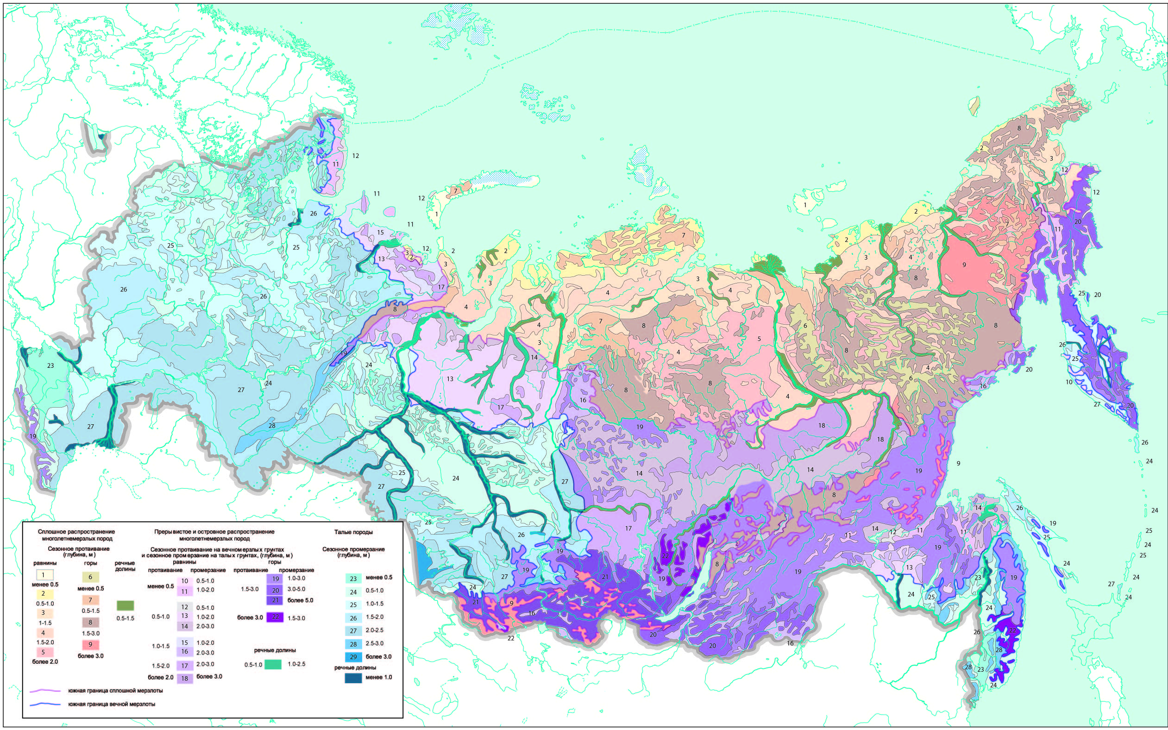
Thanks for your attention!

